Slide 1
Bridging the Youth Adult Gap

Slide 2
Learning Objectives
Learning Outcomes:
Understand how young people view adult advisers
Learn characteristics of different generations
Identify strategies for breaking down barriers and building trust
Practice methods to bridge age gaps

Slide 3
How young people view adult advisers

Slide 4
WORDS TO DESCRIBE ADVISERS

Slide 5
Characteristics of Generations

Slide 6
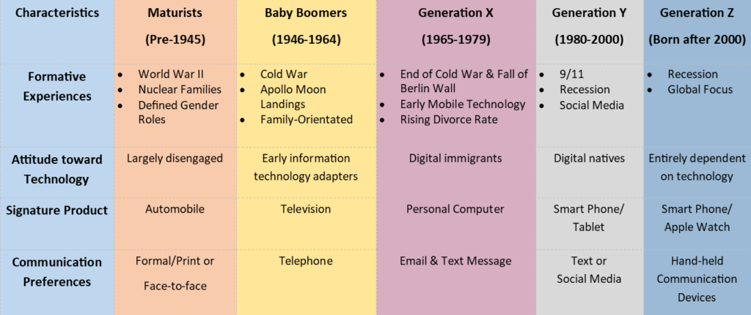

Slide 7
Strategies for breaking down barriers and building trust

Slide 8
Visualizing the generations
No communication
No loopholes
Line up from youngest to oldest
No other directions

Slide 9
Working with multiple ages
While in line, count off so we have groups of 3-4
  Presenter will tell you what number to count to
1s gather together, 2s gathers, etc.
How to build trust without a common language?

Slide 10
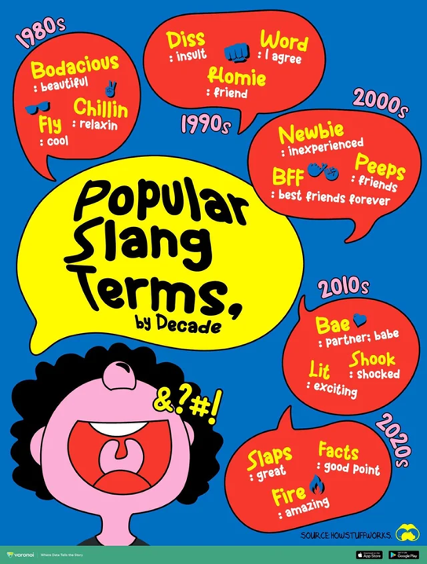

Slide 11
Methods to bridge age gaps

Slide 12
Bridging concepts
Establish a common vision for the future
Find commonality
Show up
Respect space

Slide 13
Learning Objectives
Learning Outcomes:
Understand how young people view adult advisers
Learn characteristics of different generations
Identify strategies for breaking down barriers and building trust
Practice methods to bridge age gaps

