Slide 1
Bringing the Vision
to Life

Slide 2
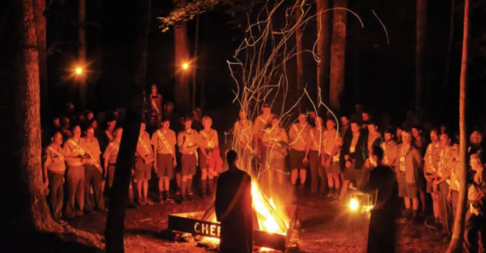
Learning Outcome
Understand how to best use the topics covered throughout the day to best serve our chapters and lodges.
Learn how to create positive change following the departure of this event.

Slide 4
The Vision

Slide 5
The “Fire” of Scouting

Slide 6
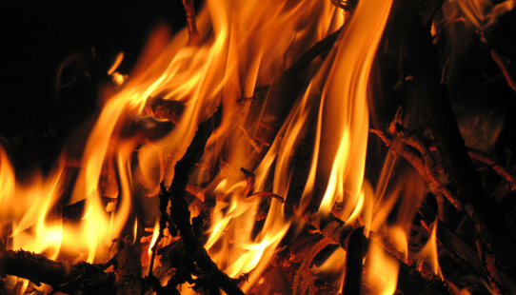
Picture Slide
Our vision guides our mission, we keep scouts in scouting!
The “Fire”

Slide 7
Learning Outcomes
Understand how to best use the topics covered throughout the day to best serve our chapters and lodges.
Learn how to create positive change following the departure of this event.

Slide 9
Take Away Challenge
”What is one thing that I learned that I can put into action in my lodge or chapter?”
&
“What type of leadership skill have I developed that will prepare me to best serve my fellow scouters?”

