Slide 1
Creating a Culture:
Making Authentic Relationships

Slide 2
Learning Objectives
Learning Outcomes:
Identify and apply the three steps of building authentic relationships.
Create one strategy to strengthen lodge culture and belonging.
Explain how relationships impact retention and choose one improvement to implement.

Slide 3
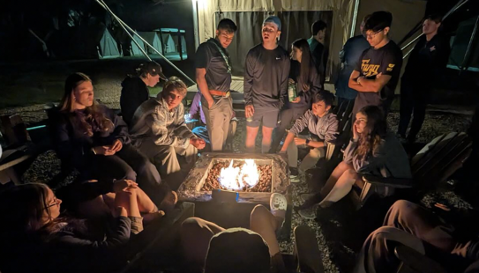
Discussion Question
Answer the following question:
  “What makes someone feel they truly belong?”
Turn to a partner and discuss the question and share out!
2025 NCOC

Slide 4
Why Do Relationships Matter?

Slide 5
CONNECTION =
RETENTION

Slide 6
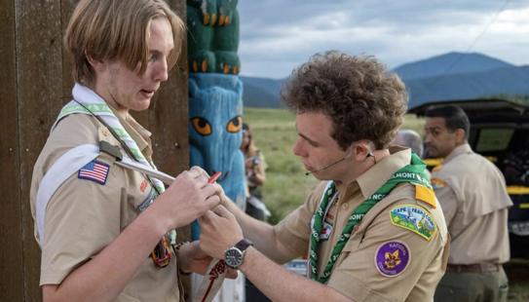
Discussion Question
“Think about your own OA and scouting experience—what’s one time a relationship made a difference in whether you stayed involved or felt connected?”
2025 NCOC

Slide 7
3 Effective Steps for Creating Authentic Relationships

Slide 8
1: Active Listening

Slide 9
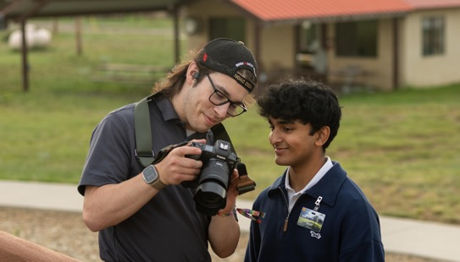
1: Listening Actively
“Which of the following is an example of intentional listening?”
  A. Waiting until they finish speaking so you can tell your story
  B. Making eye contact, nodding, and asking a follow-up question
  C. Looking around the room while they talk, then offering advice
  D. Texting someone back while they explain a problem

Slide 10
1: Listening Actively
“Which of the following is an example of intentional listening?”
  A. Waiting until they finish speaking so you can tell your story
  B. Making eye contact, nodding, and asking a follow-up question
  C. Looking around the room while they talk, then offering advice
  D. Texting someone back while they explain a problem

Slide 11
Active Listening Activity
Instructions:
  In pairs, have one person share something exciting they’ve done recently while the other practices active listening (no interrupting, just reflecting and asking one follow-up question)
  Once the first person has concluded, please switch roles!

Slide 12
1: Listening Actively
Benefits of Listening Actively
  Unique perspectives and positive growth/change in program areas and lodge operations
  Diverse opportunities to ensure that all are encouraged and welcome to whatever program your chapter or lodge is offering.
  Better relationships can be built from listening to those individuals with whom you work in a scouting setting. This allows you to recognize and utilize the strengths of the people around you.

Slide 13
2: Recognize the Small Things

Slide 14
The fundamentals of the fine details
Celebrate quiet leadership, not just spotlight moments
Creating a culture that supports the work of chapter and lodge volunteers, whether they have an elected or appointed position, can influence the work of both youth and adult participants.

Slide 15
The fundamentals of the fine details
Acknowledge effort, even when it doesn’t lead to success
When following up, utilize the small details of a larger project to provide positive and constructive feedback

Slide 16
The fundamentals of the fine details
Use the tool of “Thank you.”
Saying “Thank you” shares the idea of acknowledgement and reinforcement to develop positive workspaces.

Slide 17
The fundamentals of the fine details
Small gestures can create large ripples.
It is the understanding that all actions among chapter and lodge operations seem month by month, but the small steps to help the lodge live its vision will help shape the culture and overall future of the local lodge experience.

Slide 18
Discussion Question
Think of a small, kind action you noticed someone do this week.
Why did that stand out?
2025 NCOC

Slide 19
3: Follow Up When Applicable

Slide 20
Follow Up Whenever Applicable
Keep track of what others share (use notes or memory triggers)
A simple “How did that go?” or “What are you excited to do next time?” can mean a lot
Helps others feel supported and remembered
Builds accountability and encourages future sharing

Slide 21
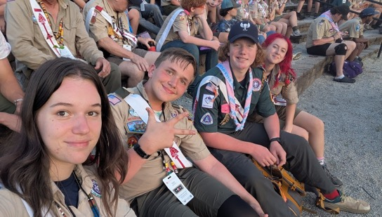
Discussion Question
Can you recall a time when you told someone something small - like a goal or event? If so, how did it make you feel when they remembered this conversation or aspiration?
Egwa Tawa Dee Lodge

Slide 22
Tighten our Links and Share our Vision

Slide 23
The 3 Factors to Great Culture
Culture is not by mistake; it is by example
Invite others to share with you
Put it into perspective

Slide 24
Closing Thoughts

Slide 25

Vision Circle
Instructions:
Break into groups of 3 - 4
Answer the question…“What would our chapter/lodge/section look and feel like if everyone felt welcomed, valued, and involved?”
All participants in the circle share one though..
  “It would feel more like…”
  “I think more people would…”
  “I’d personally feel more…”
Each group will have 3 minutes of discussion

Slide 26
Learning Objectives
Learning Outcomes:
Identify and apply the three steps of building authentic relationships.
Create one strategy to strengthen lodge culture and belonging.
Explain how relationships impact retention and choose one improvement to implement.

Slide 27
“Culture is not an initiative. Culture is the enabler of all initiatives.”
Larry Senn

