Slide 1
Enhancing Lodge Outreach and Engagement

Slide 2
Learning Objectives
Discuss the importance of communications within a lodge setting to engage members in any role
Understand two-way communication
Understand forms of external promotions and how social media isn’t always the answer
Create an action plan for lodge communications

Slide 3
Effective Communication

Slide 4
What is Effective Communication?
Effective Communication is PURPOSEFUL, CLEAR, and TIMELY transmission of messages that are tailored to the audience.

Slide 5
What is Communication?
Communication is the act of transferring information from one person, place, or group to another and requires a sender, a message, and a recipient.

Slide 6
What is Two-Way Communication?
Two-Way Communication is an active process where the recipient of the communication responds or provides feedback to the sender.
Why is Two-Way Communication
important to the Order of the Arrow?

Slide 7
Why Two-Way Communication?
Promotes Engagement
Creates Trust and Transparency
Increases Clarity
Strengthens Relationships

Slide 8
Who is Your Audience?

Slide 9
Who is Your Audience?
Youth
Instagram
TikTok
Facebook
Other Social Media
Memes
Stories
Adults/Parents
Physical Invitations
  Postcard/Newsletter
Emails
Handouts
Elevator Pitches

Slide 10
What promotion methods have you found effective?

Slide 11
Communication Action Plan

Slide 12
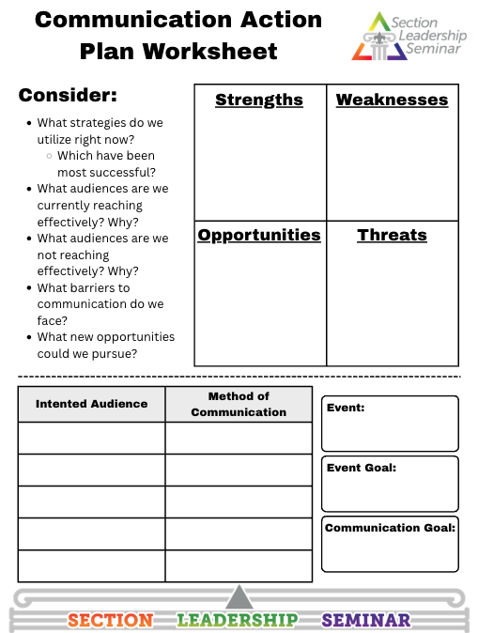
Communication Action Plan
Work with your Lodge to fill out the Communication Action Plan.
Start with the SWOT analysis and then pick an upcoming event and decide which methods you will use to promote it.

Slide 13
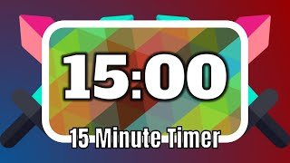
Timer

Slide 14
Let’s Share!

Slide 15
Learning Objectives
Discuss the importance of communications within a lodge setting to engage members in any role
Understand two-way communication
Understand forms of external promotions and how social media isn’t always the answer
Create an action plan for lodge communications

Slide 16
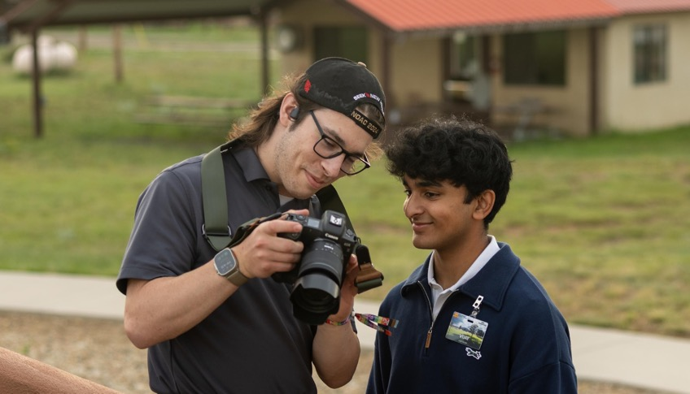
How to Contact Me (Optional)
Email:
Phone:
[Insert image of presenter above]

