Slide 1
Living Our Mission in the Order of the Arrow

Slide 2
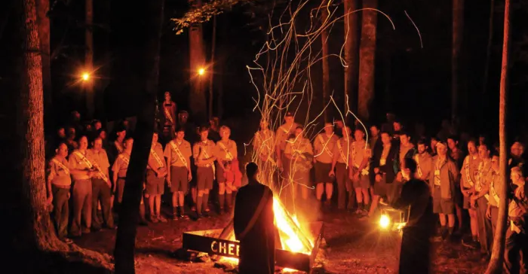
Learning Outcome
Understanding the mission of the Order of the Arrow and Scouting America
How the mission of Scouting shapes our experience in the Order of the Arrow

Slide 4
The Mission

Slide 5
The Mission of the Order of the Arrow:
“To achieve the mission of Scouting America through transformative fellowship that ignites limitless Scouting journeys.”

Slide 6
The Mission of Scouting America:
“To prepare young people to make ethical and moral choices over their lifetimes by instilling in them the values of the Scout Oath and Law.”

Slide 7
Piecing these Together:
“To prepare young people to make ethical and moral choices over their lifetime by instilling in them the values of the Scout Oath and Law through transformative fellowship that ignites limitless Scouting journeys.”

Slide 8
Breaking It Down

Slide 9
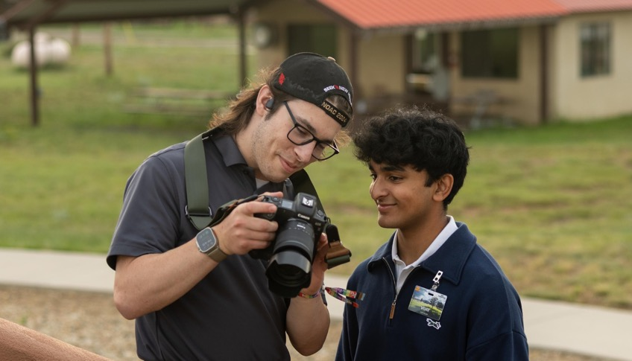
The Mission
To prepare young people
to make ethical and moral choices over their lifetime
by instilling in them the values of the Scout Oath and Law
through a transformative fellowship
that ignites limitless Scouting journeys.
2025 National Council Of Chiefs

Slide 11
Wrap Up

Slide 12
Learning Outcome
Understanding the mission of the Order of the Arrow and Scouting America
How the mission of Scouting shapes our experience in the Order of the Arrow

