Slide 1
Patch Concepts

Slide 2
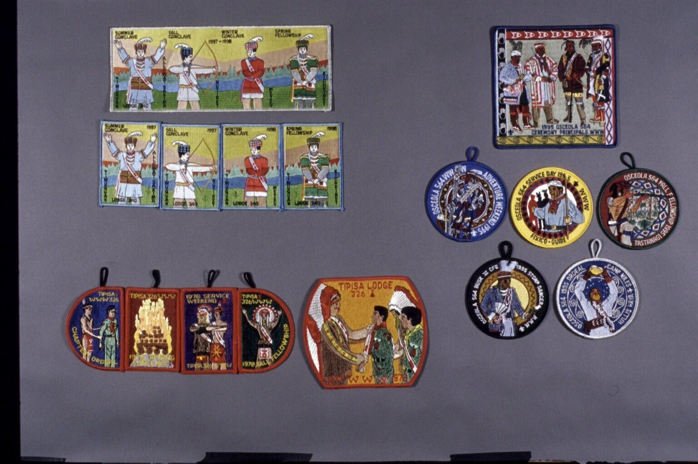
CEREMONIAL TEAM

Slide 3
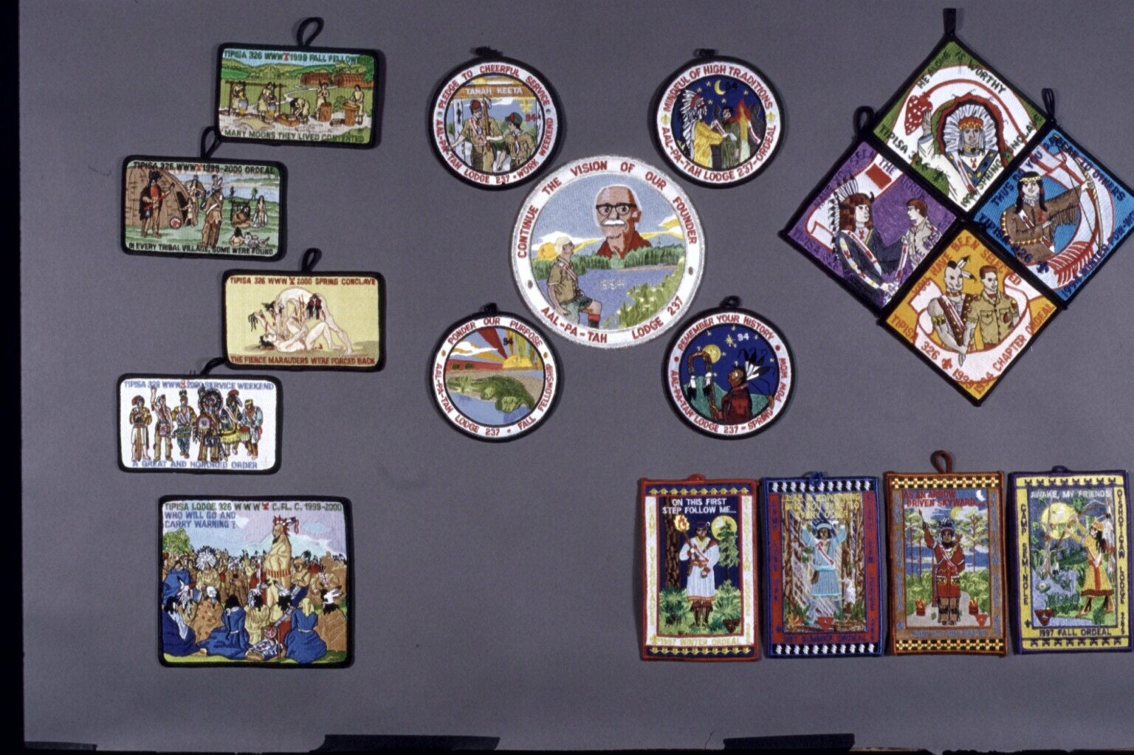
CEREMONIAL LINES

Slide 4
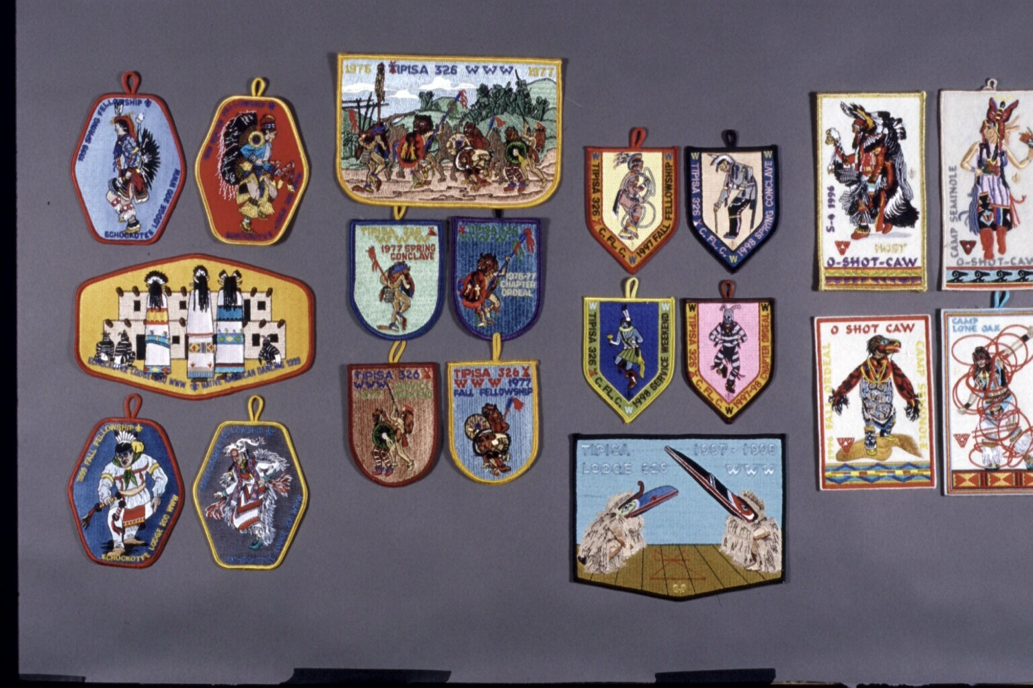
NATIVE AMERICAN DANCERS

Slide 5
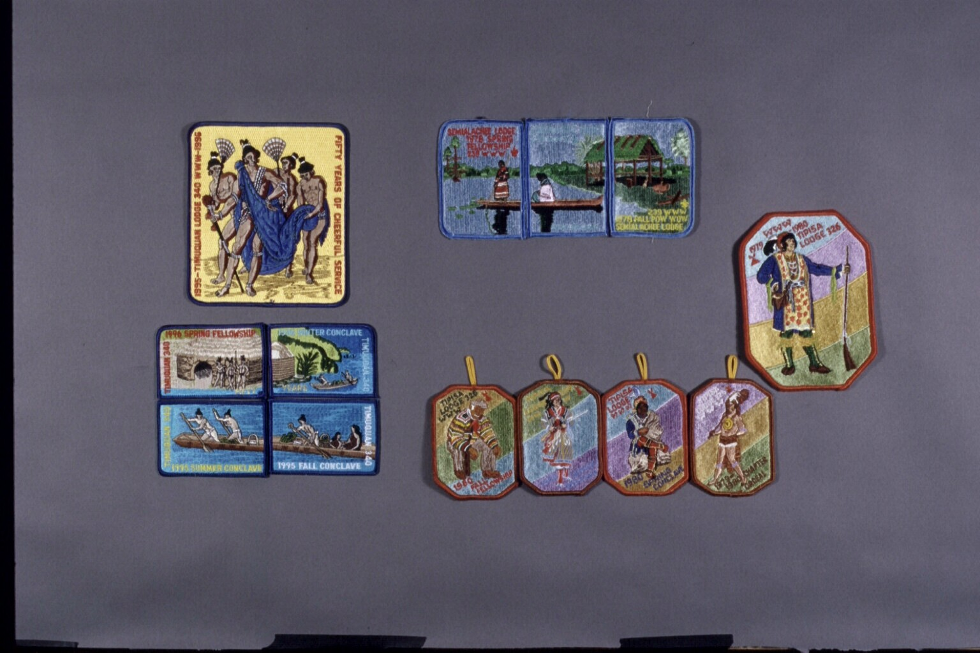
LOCAL NATIVE AMERICANS

Slide 6
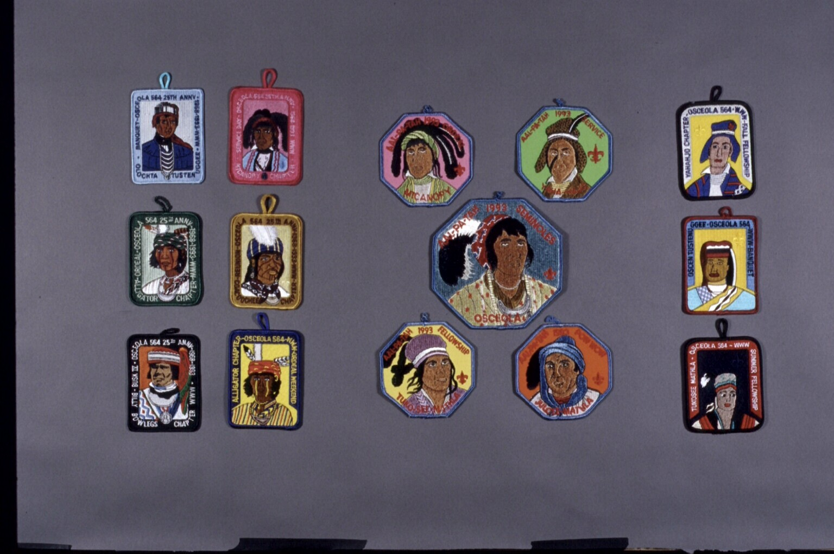
McKENNEY-HALL PORTRAITS

Slide 7
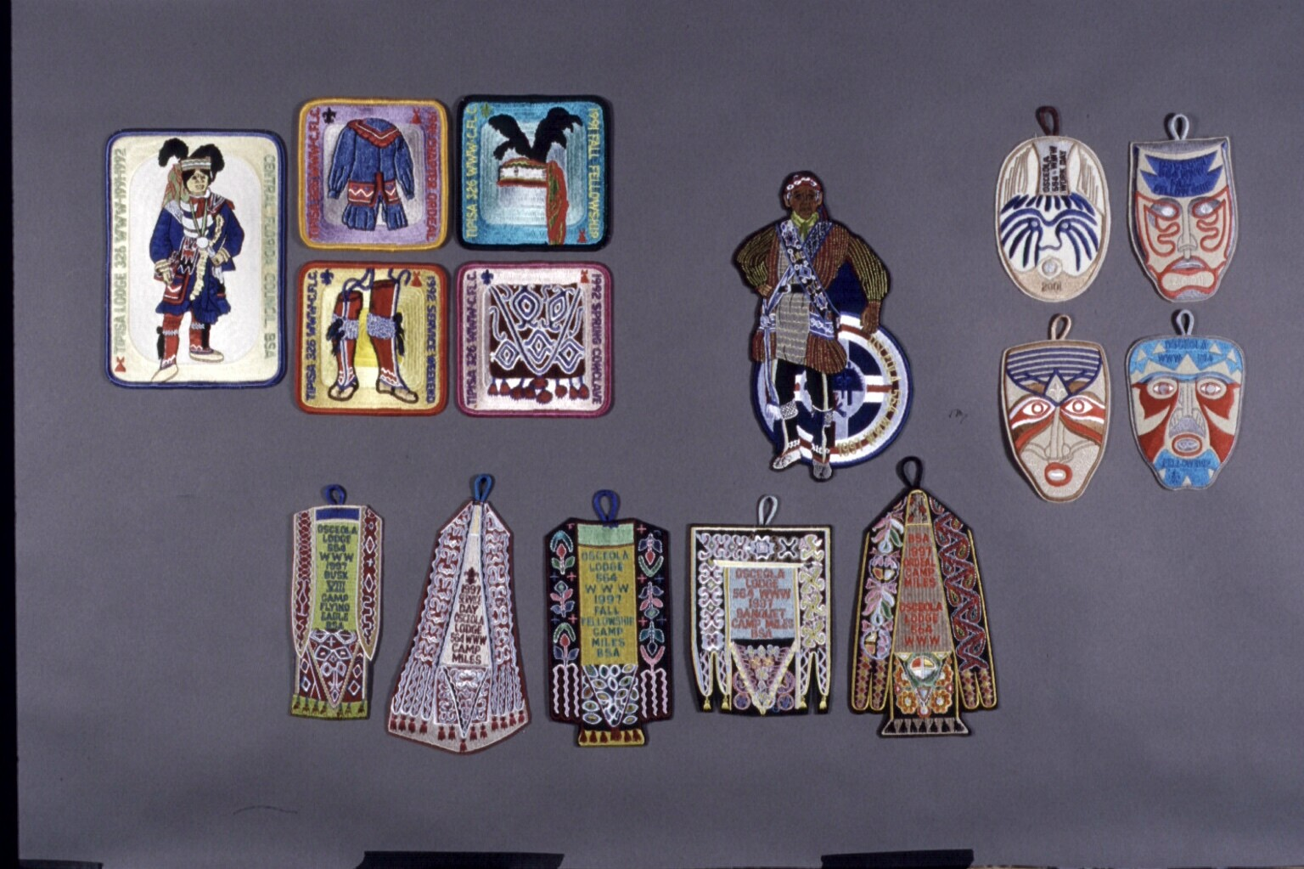
LOCAL NATIVE AMERICAN CLOTHING

Slide 8
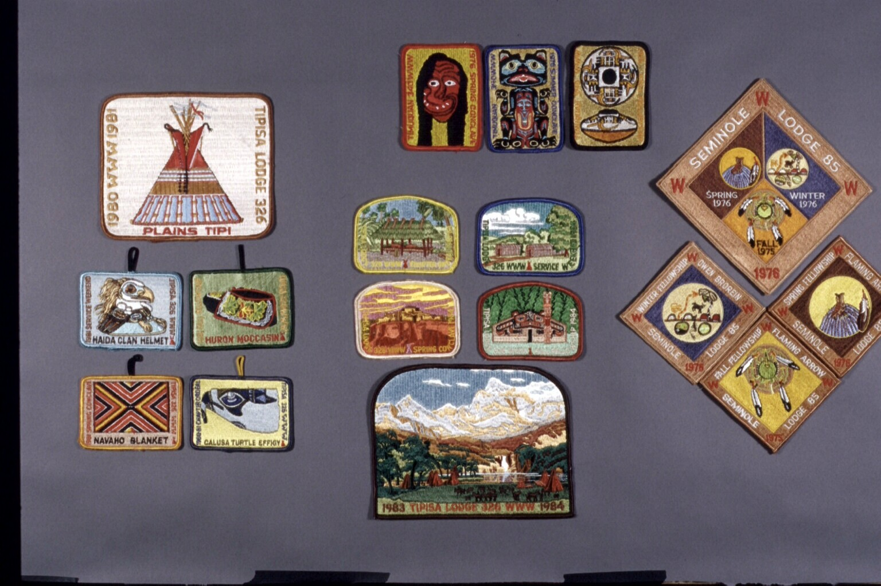
NATIVE AMERICAN ARTIFACTS

Slide 9
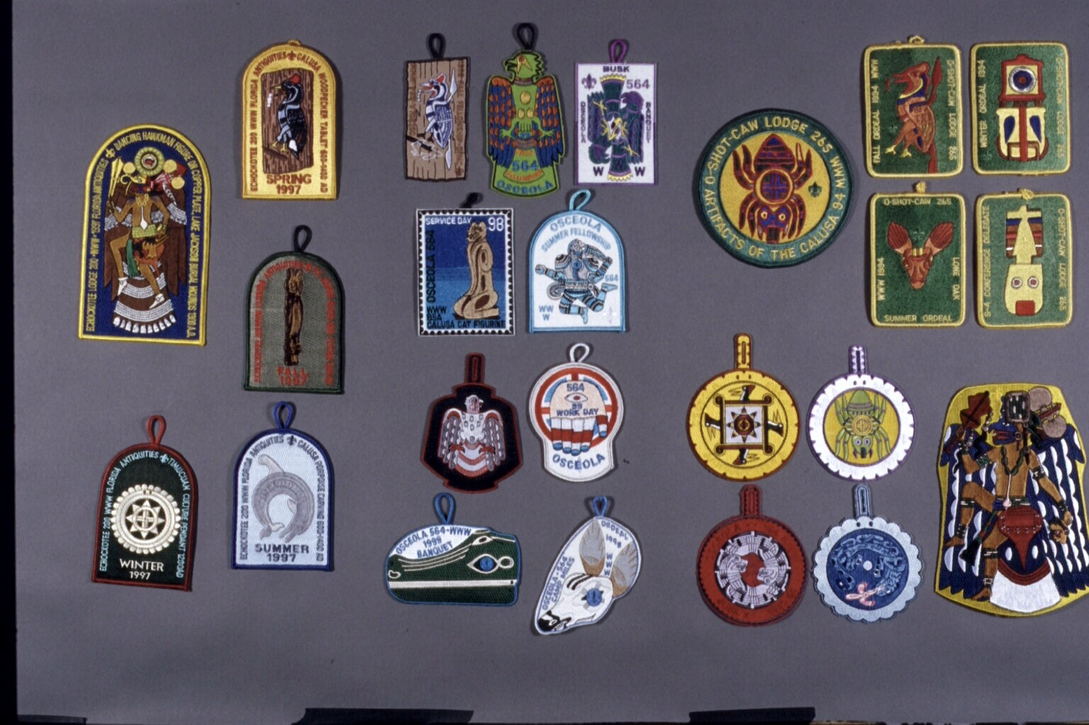
LOCAL NATIVE AMERICAN ART

Slide 10
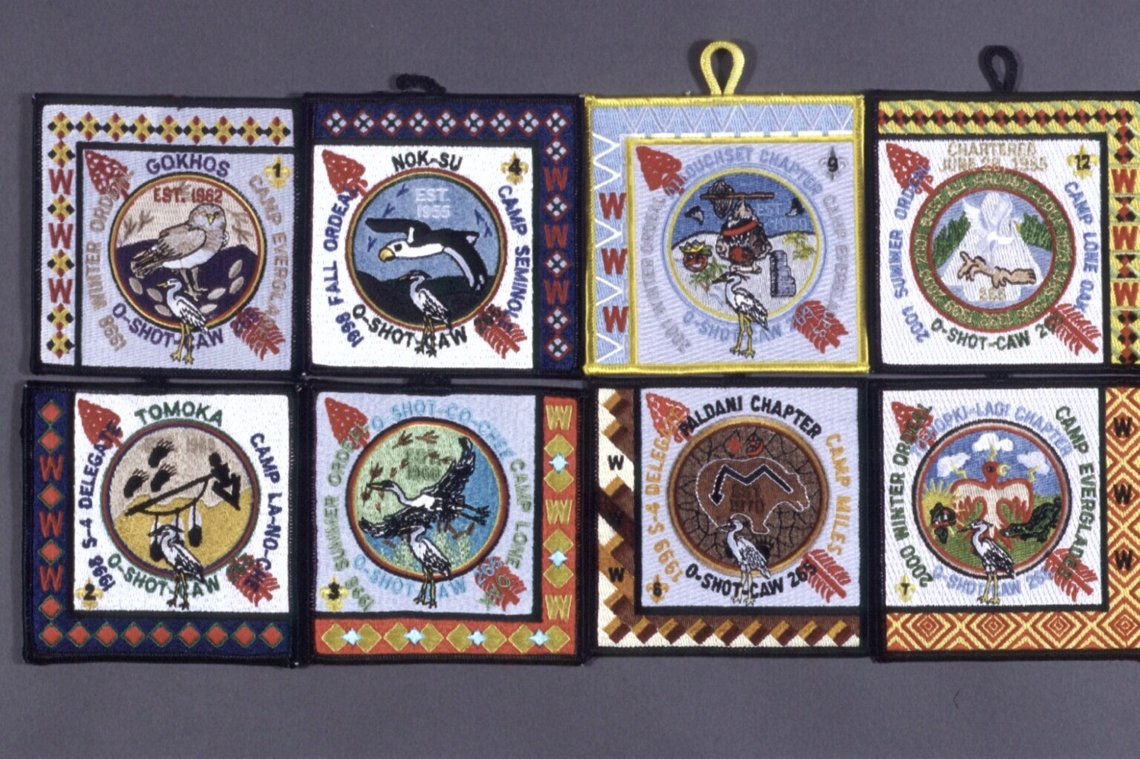
NATIVE AMERICAN BORDERS

Slide 11
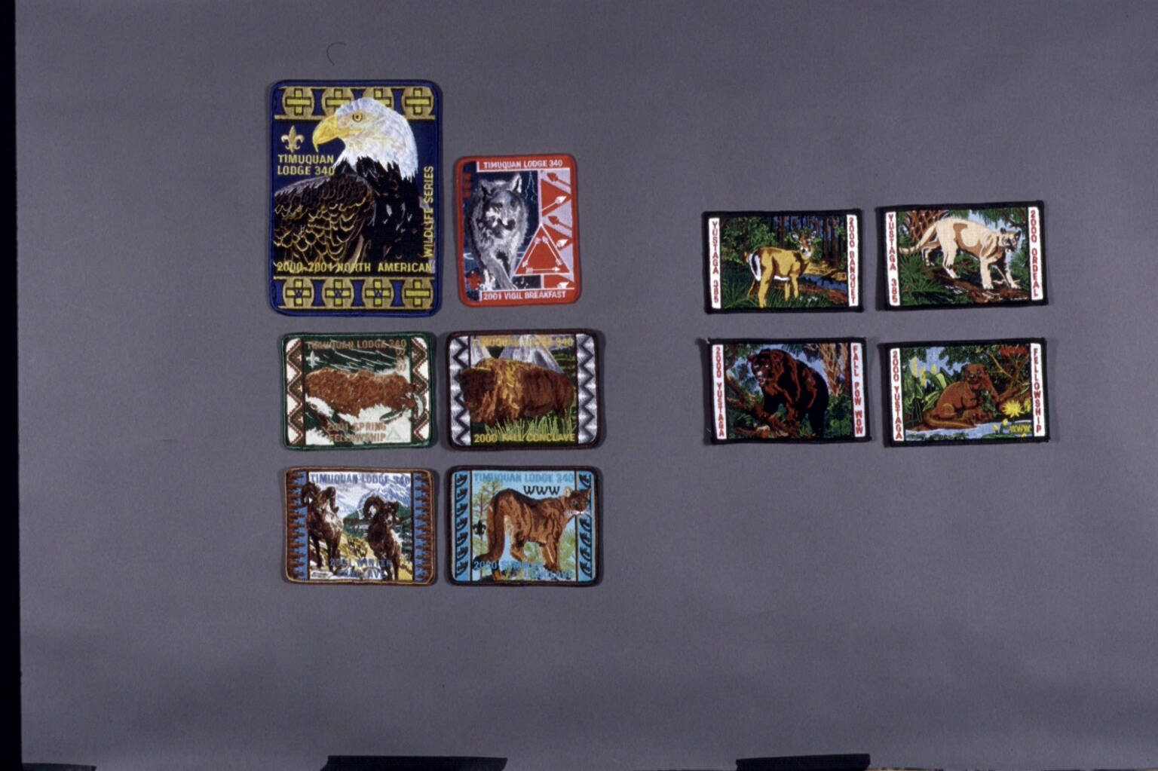
ANIMALS

Slide 12
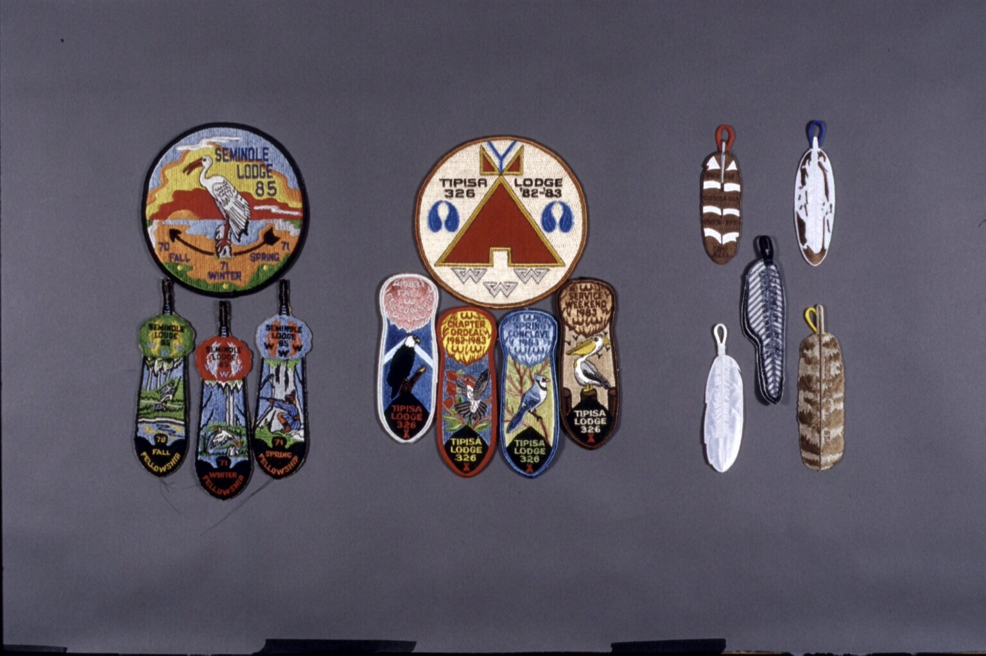
BIRD FEATHERS

Slide 13
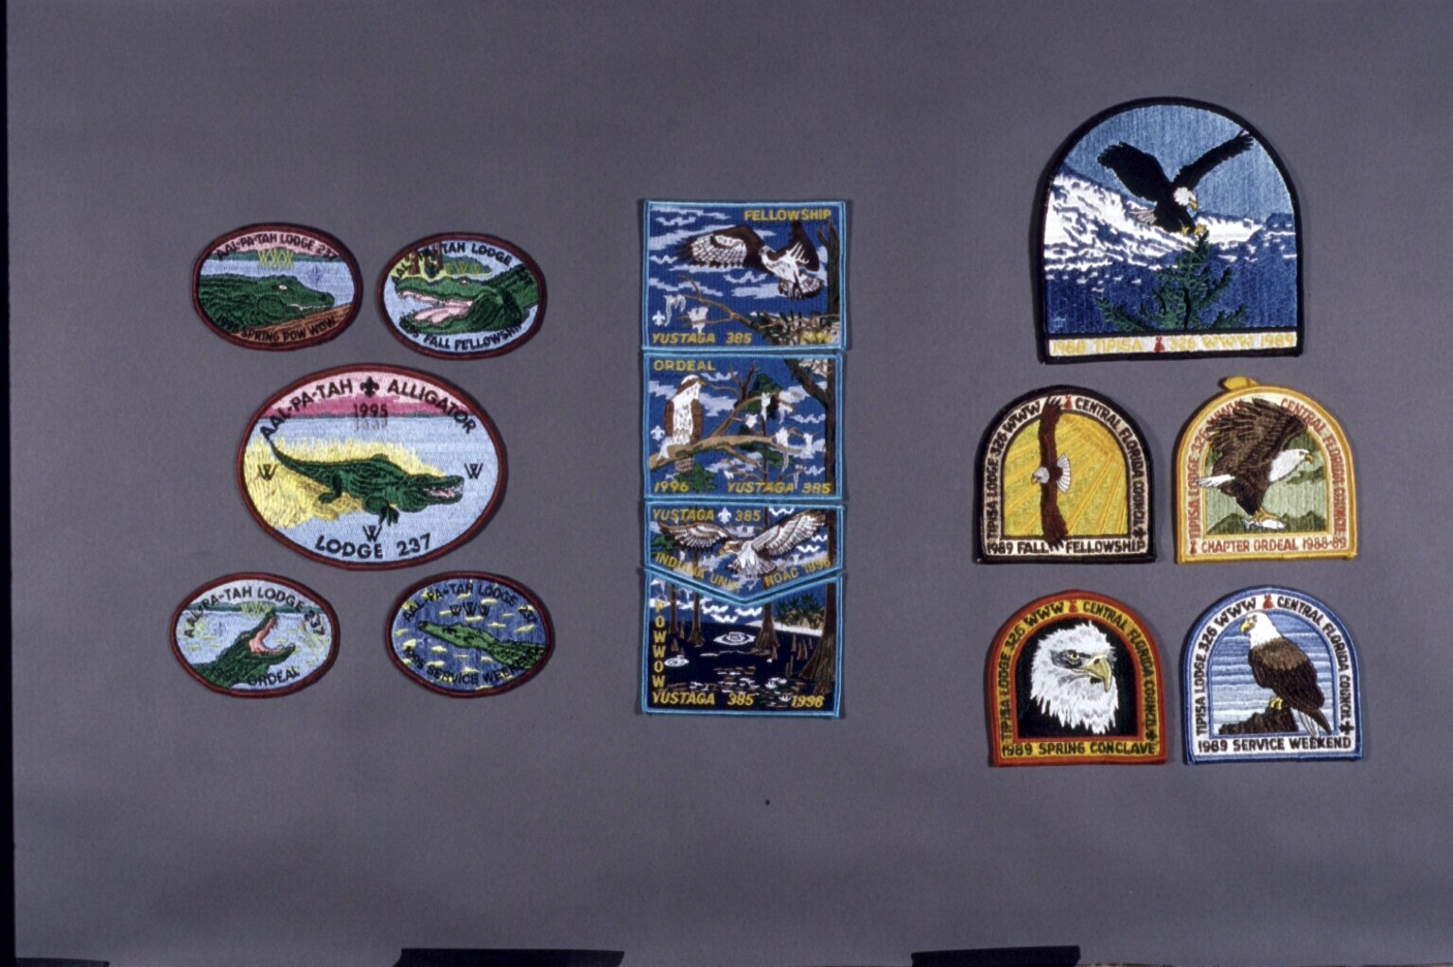
LODGE TOTEM ANIMALS

Slide 14
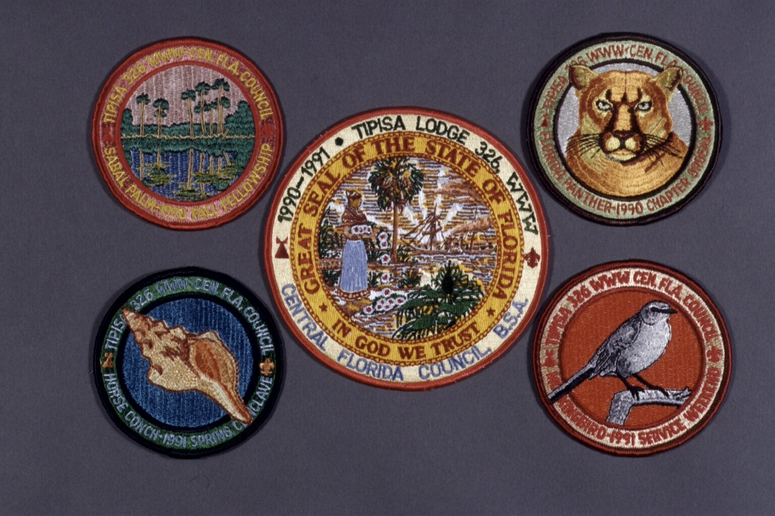
OFFICIAL STATE THINGS

Slide 15
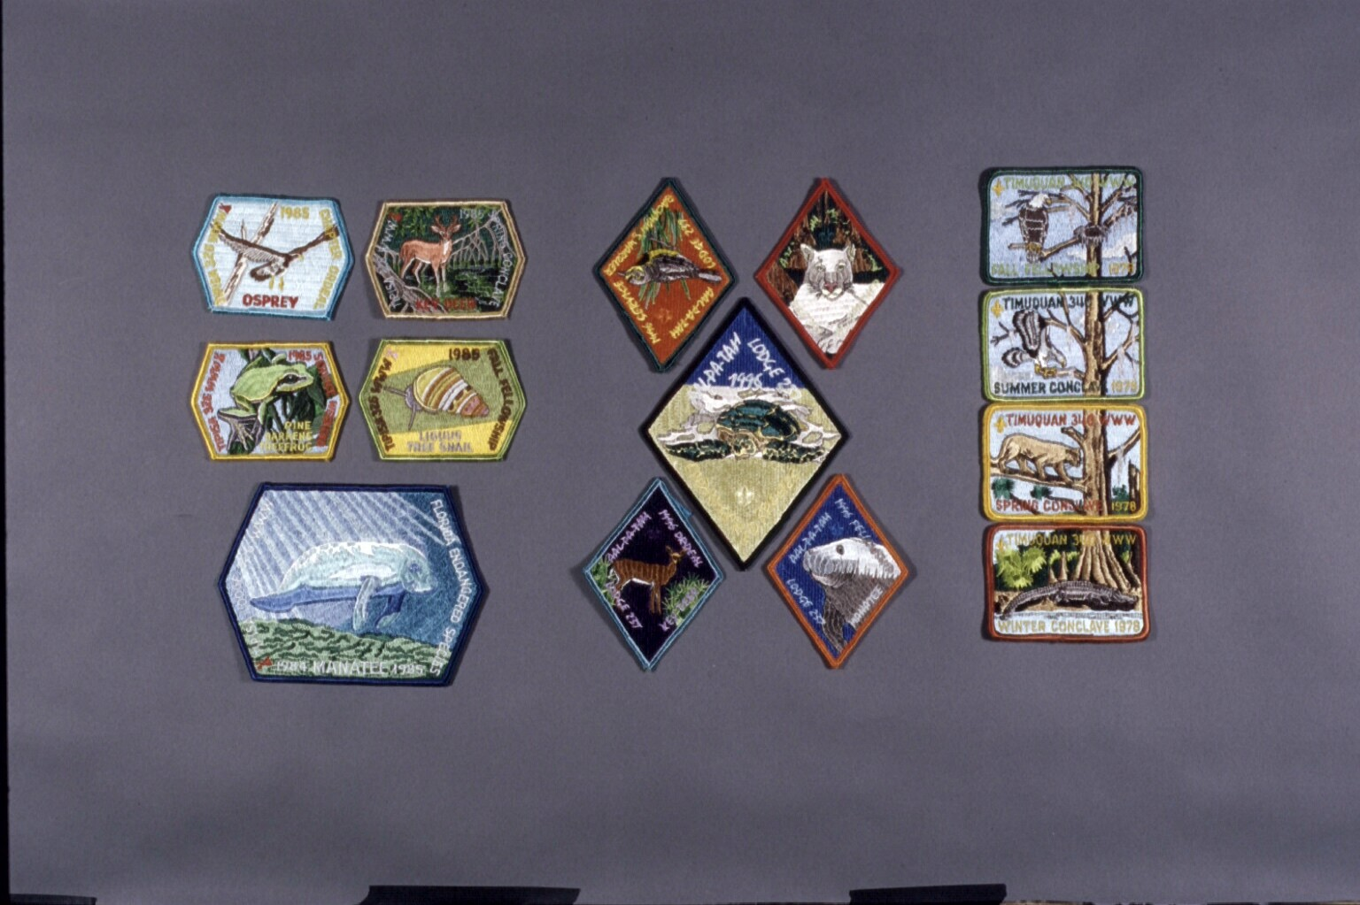
LOCAL ANIMALS

Slide 16
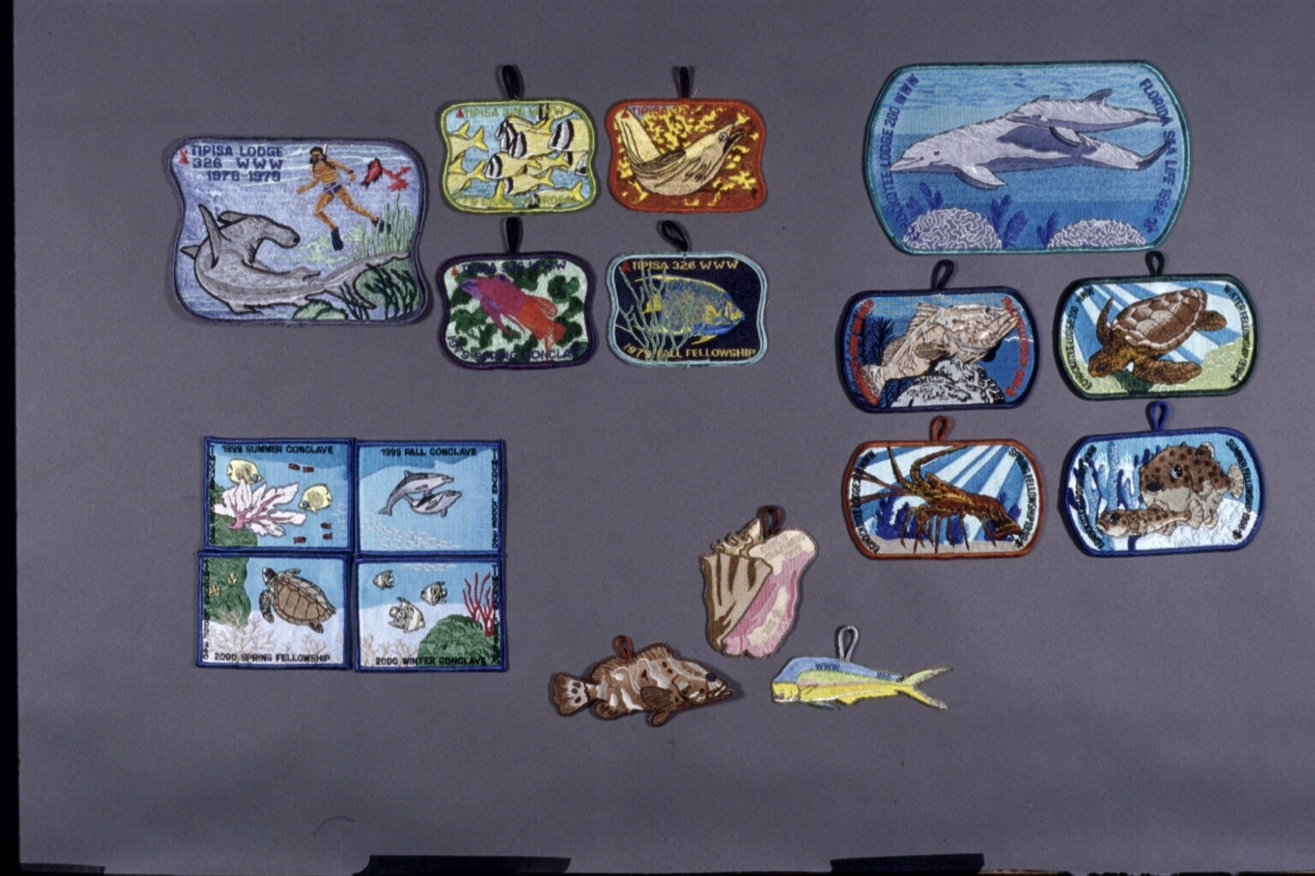
LOCAL FISH

Slide 17
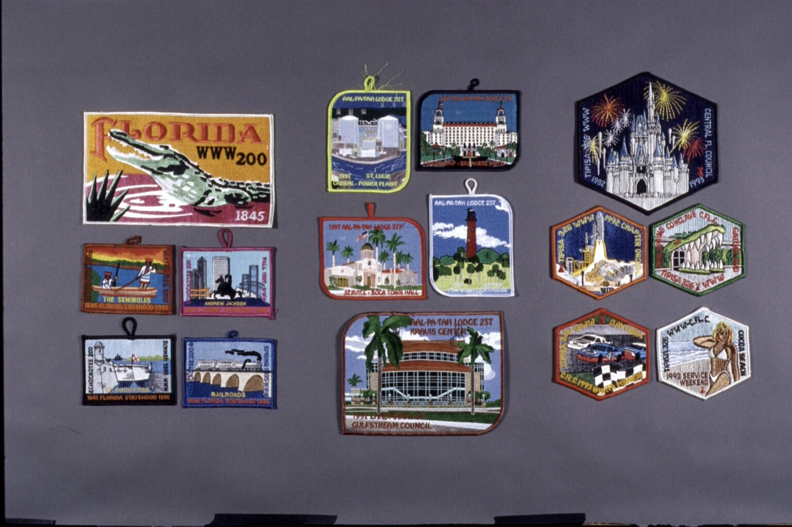
LOCAL LANDMARKS

Slide 18
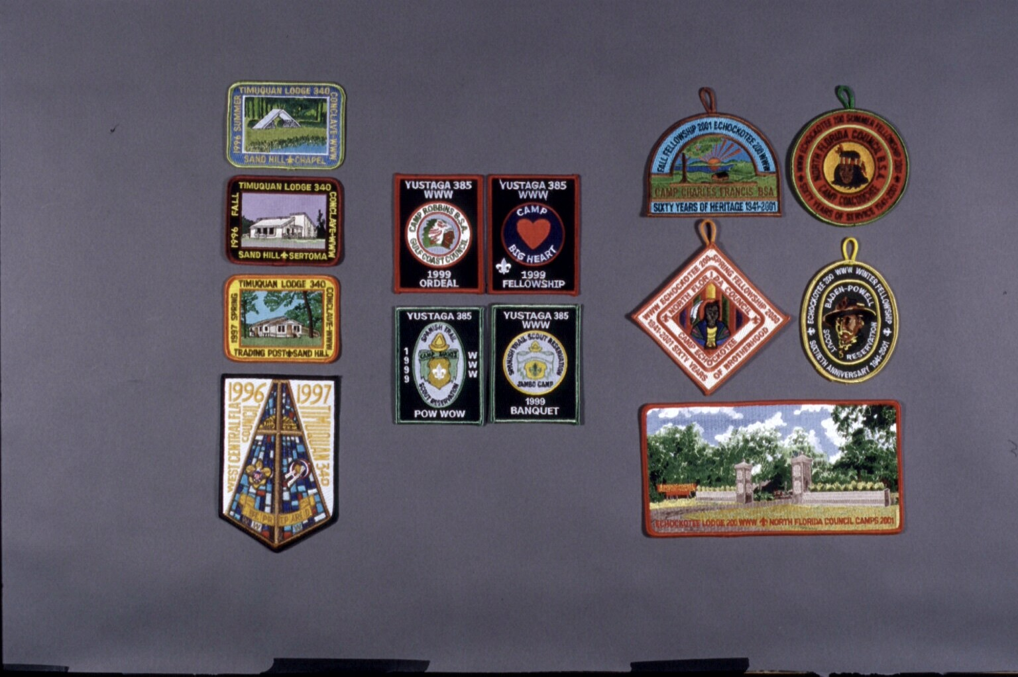
YOUR COUNCIL’S CAMPS

Slide 19
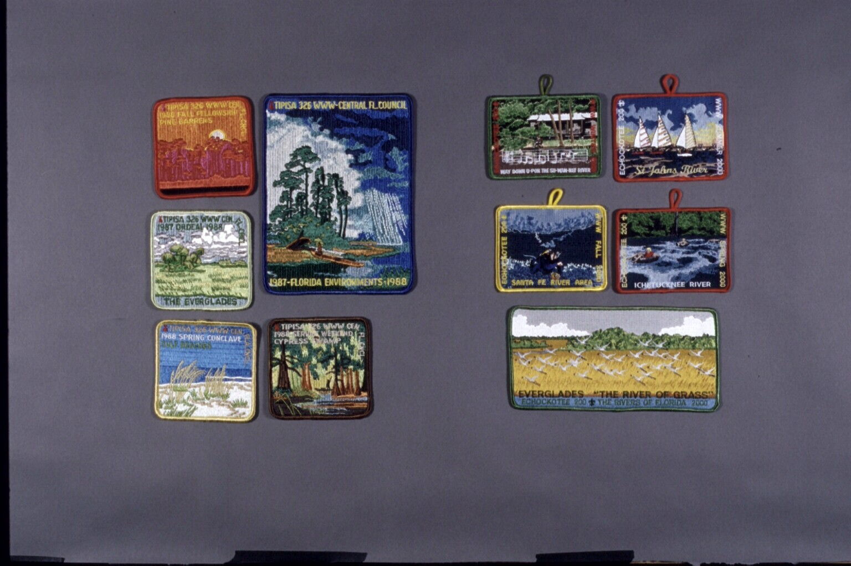
LOCAL ENVIRONMENTS

Slide 20
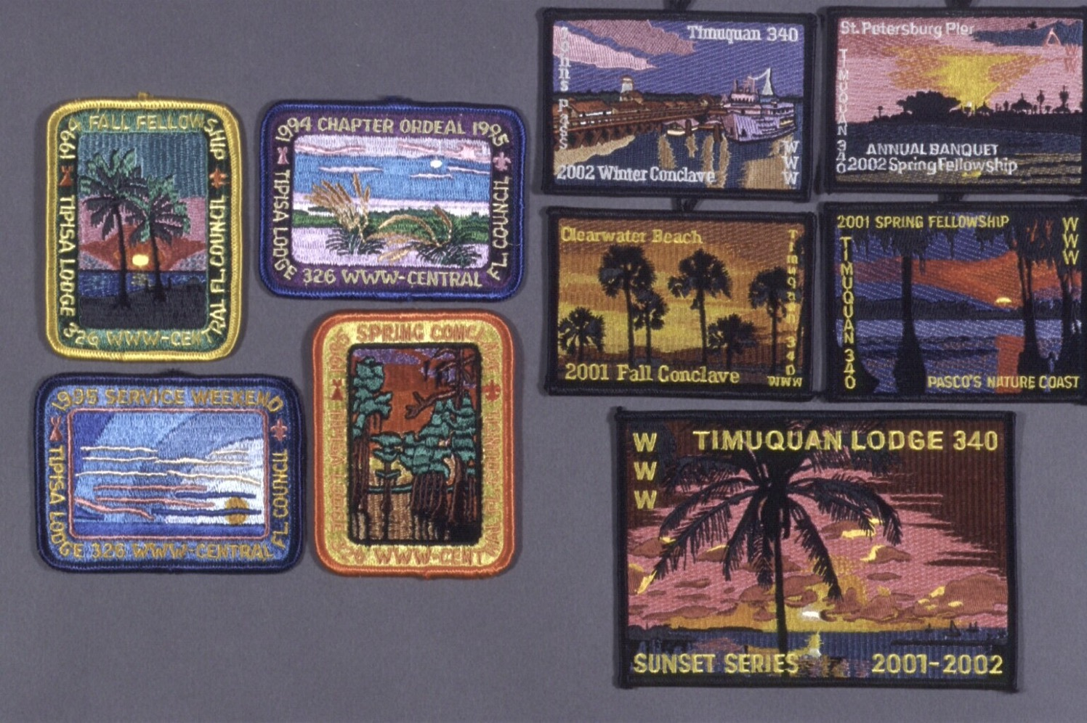
LOCAL SKIES

Slide 21
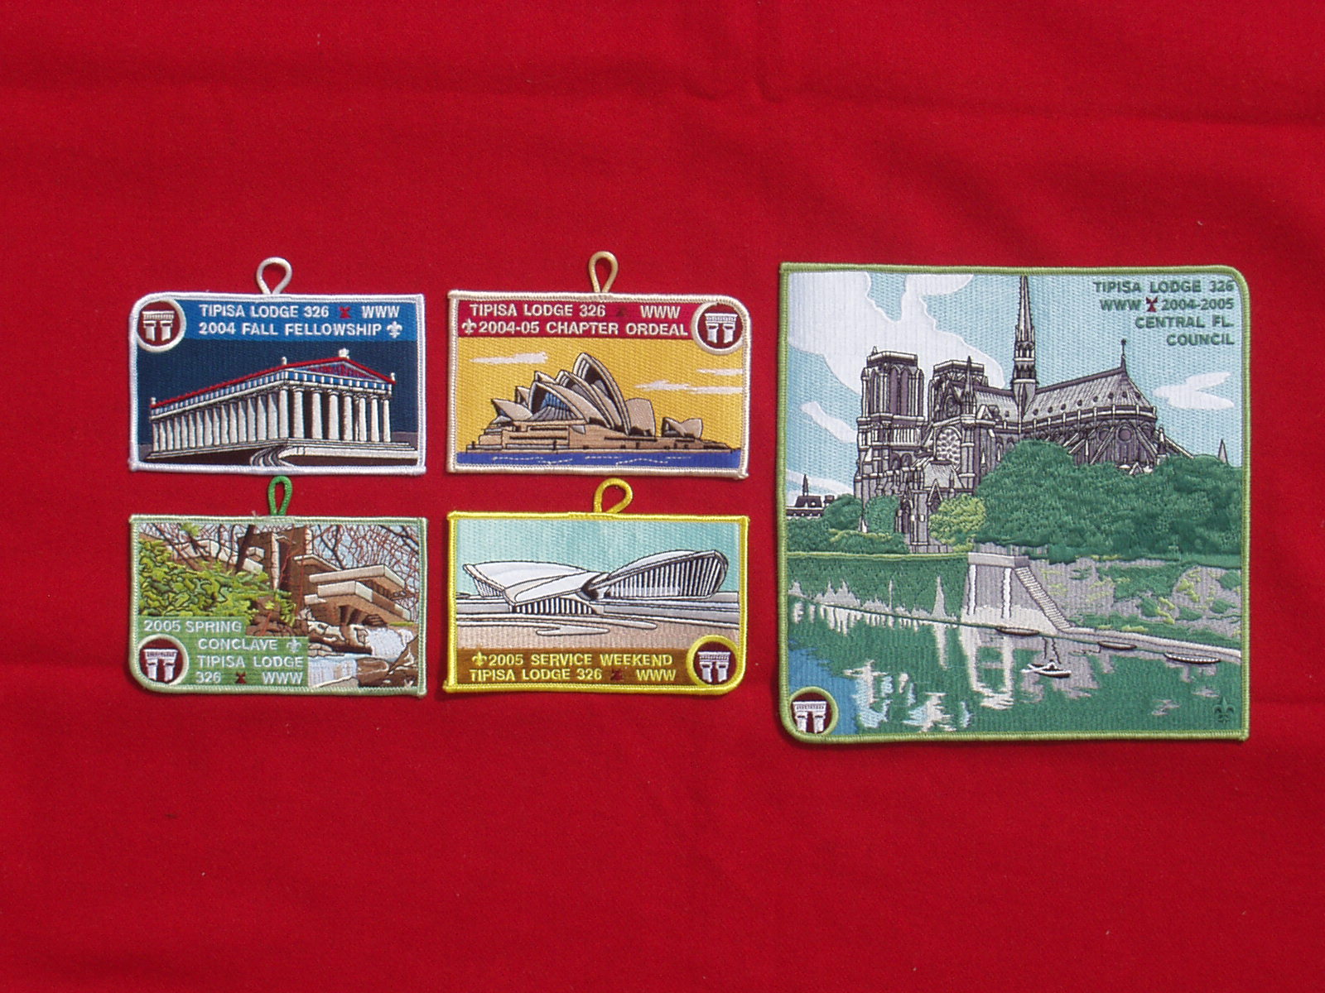

Slide 22
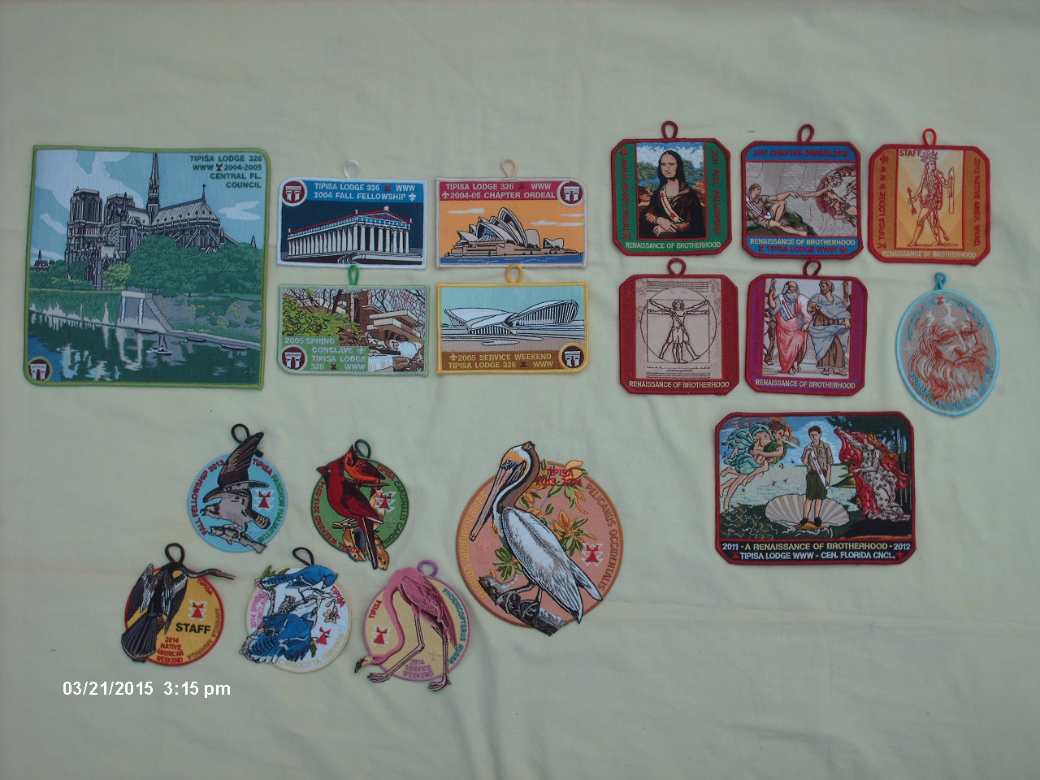
MERIT BADGES

Slide 23
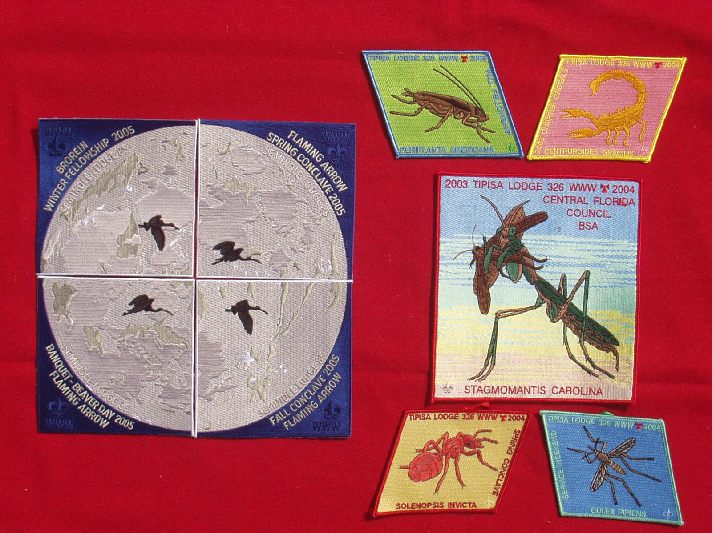

Slide 24
For Training Resources and More Information Visit:
http://training.oa-bsa.org/noac2015

