Slide 1
Unity in Variety

Slide 2
Learning Objectives
Learn how to identify new voices and encourage conversations
Practice how to have those conversations
Identify the benefits of breaking the echochamber and create an action plan

Slide 3

Get to Know Each Other
Turn to someone next to you and share at least one non-Scouting interest!

Slide 4
Why is it important that we identify new voices among our lodges?

Slide 5
Importance of New Voices
1. They offer a fresh perspective
3. It aids in belonging and retention
2. They provide sustainability
4. It shines a light on unseen talents or skills

Slide 6
Scenario 1

Slide 7
Scenario Example
Scenario: A chapter is working on creating a new t-shirt to sell as part of a fundraiser. The officer team has tried to draw several ideas, but none of them have turned out as they wanted. Who could the officer team turn to for assistance?
Examples of people to turn to: a new adult Arrowman who is an Art Teacher at the local middle school, an Arrowman who regularly designs t-shirts for their club at school, and an Arrowman whose family runs a local t-shirt company that offers design consulting.

Slide 8
Let’s Share!

Slide 9
How to Approach Conversations
Focus on forming a genuine connection first, and worry about finding a role of them second.
Be curious
  Get to know this Arrowman as a person
Bridge their personal interests to opportunities in the OA
Celebrate their contributions and keep encouraging them

Slide 10
Practice Starting Conversations
In the first round, Partner A is going to be the new Arrowmen. Partner B is going to be the active Arrowmen and is going to practice starting a conversation, asking questions, and gently connecting Partner A’s interests to lodge or chapter activities.
In the second round, you are going to switch roles.

Slide 11
Practice Debrief
What did it feel like to be approached naturally versus recruited right away for a role?
Which questions helped the conversation flow?
How can you take these skills back to your chapter/lodge?

Slide 12
Breaking the Echochamber

Slide 13
What is an Echochamber
An Echochamber occurs when the same voices and perspectives dominate the conversation and everyone begins to think alike.
Limits Creativity
Discourages Participation
Burns out Leaders
Misses Hidden Talents

Slide 14
Scenario 2

Slide 15

Address the Challenge
You have 15 minutes to create a plan to address your groups challenge. You must use everyone’s abilities.

Slide 16
Challenge Debrief
Which skills made the biggest difference?
Was anyone’s skill overlooked at first? How did you bring them in?
What does this teach us about breaking the echo chamber in our lodges?

Slide 17
Learning Objectives
Learn how to identify new voices and encourage conversations
Practice how to have those conversations
Identify the benefits of breaking the echochamber and create an action plan

Slide 18
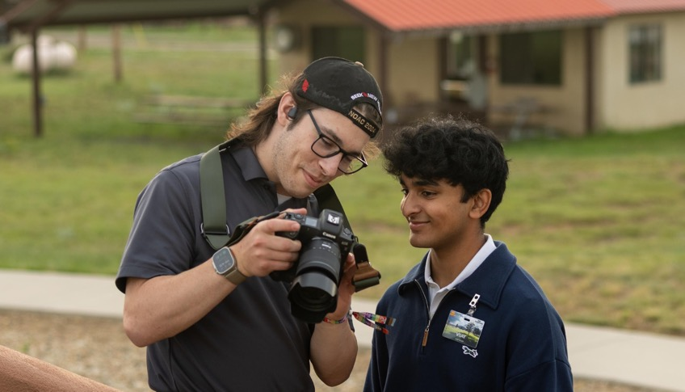
How to Contact Me (Optional)
Email:
Phone:
[Insert image of presenter above]

