Slide 1

Effective Listening
“Seek first to understand, then to be understood.”
Stephen Covey

Slide 2
Two Parts of Effective Listening
“Active” reflects what a person is saying to confirm comprehension
and
“Empathetic” a sincere attempt by a listener to understand in depth what a speaker is saying.

Slide 3
Listening in Adversarial Situations
Listeners should always strive to create a positive present as opposed to a negative past.

Slide 4
Effective Listening
You can give caring feedback without a good technique, but the slickest technique in the world will not hide a lack of caring.

Slide 5
Effective Listening: Summary
“Effective Listening” is a skill we can learn
Plays a role in forming relationships, developing teams and finding solutions
The best Listening is both “Active” and “Empathetic”
“Listening” can be a tool for turning a negative situation into a positive

Slide 6
Servant Leadership
The most effective Leaders put those whom the lead first (others-first leadership)
Good Leaders see themselves as serving those they lead, enabling their success

Slide 7
The Leading Edge
Describes the behavior of a leader as the team moves through the stages of development

Slide 8
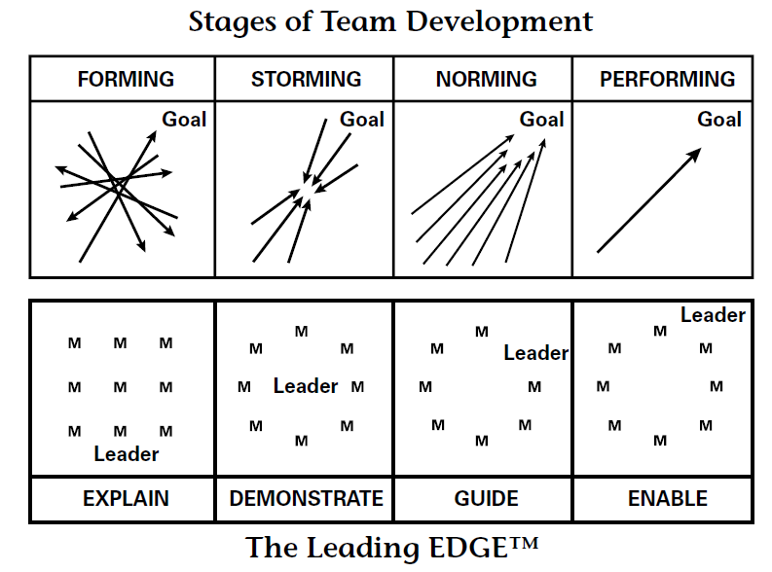
The Leading Edge

Slide 9
The Teaching Edge
Describes the behavior of an instructor as a learner goes through the stages of learning a skill

Slide 10
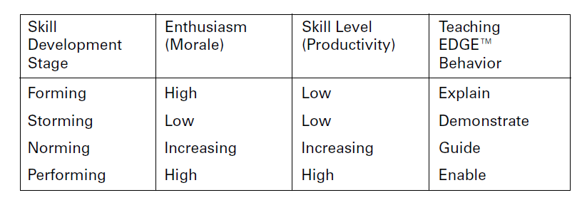
The Teaching Edge

Slide 11
For Training Resources and More Information Visit:
http://training.oa-bsa.org/noac2015

