Slide 1
The NEW and Improved LLDC
Lodge Training Program

Slide 2
Learning Objectives
Understand what the LLDC is
Know how the LLDC can improve your lodge
Know how the LLDC is run

Slide 3


What is an LLDC?

Slide 4
Suggestions...
Opportunity for lodge leadership to meet together
Chance to deliver general information to lodge members
Opportunity to give information to lodge leadership about their roles and responsibilities
Occasion to develop leadership skills in all members of the lodge
Time to enjoy fun, fellowship, and learning with other Arrowmen

Slide 5
Who is Involved?
Planning and Supervising
  Key 3, appointed arrowman
Training
  Arrowmen with experience in leadership training
Participating
  All lodge leadership and interested Arrowmen

Slide 6
What is Taught?
Program
Leadership and team development
Position responsibilities
Lodge opportunities
...and much more!

Slide 7

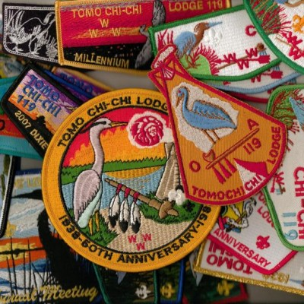
How can the LLDC fit your lodge’s needs?

Slide 8
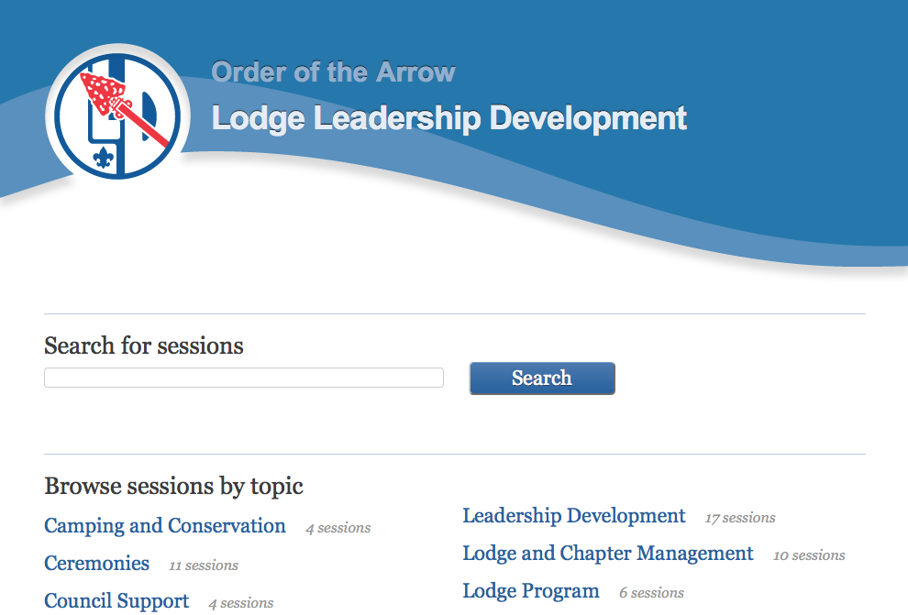

Resources
Lodge Leadership Development website:
http://lld.oa-bsa.org/2012/
Lodge Leadership Development Planning Guide:
http://www.oa-bsa.org/pages/content/publications#lldpg

Slide 9
Conclusion
You are given the training and resources to be great leaders,
be sure to apply them!
http://training.oa-bsa.org/noac2015

