Slide 1
-
ARROWMAN 101:
Looking in the Rearview Mirror

Slide 2
Why Do We Have a Rearview Mirror?

Slide 3


OA MILE MARKER GAME
When you hear the car
horn, write down your
answer to the question
that is posed.

Slide 4
The Parking Lot – Where Our Journey Began

Slide 5
1915
The Wimachtendienk Wingolauchsik Witahemui founded at Treasure Island Scout Camp in the Philadelphia Council.
Robert Craig and Gilpin Allen were the first two inductees on July 16, 1915
During that first summer a total of 25 members were inducted into the new order.
E. Urner Goodman was selected as the first Vigil Honor member.

Slide 6
Mile Marker #1
What was Dr. Goodman’s Vigil Name?
Nuwingi
“The Willing”

Slide 7
Mile Marker #2
From what popular fiction novel were the characters Chingachgook and Uncas taken?
Last of the Mohicans

Slide 8
1916
The first use of a more formal Ordeal induction process began.
The framing of the first Constitution of Wimachtendienk W.W.
The “tortoise” was selected as the general insignia of the Order.

Slide 9
Mile Marker #4
Who was the first Chief of the Wimachtendienk?
George Chapman

Slide 10
1917
Co-Founder Carroll A. Edson became our second Vigil Honor member.

Slide 11
Mile Marker #5
What was Edson’s Vigil Name?
Achewon
“The Strong”

Slide 12
THE TRIP BEGINS

Slide 13
1919
First documented expansion of the Order with Trenton Lodge (later known as Sanhican Lodge).
First youth Vigil Honor member – Howard Seideman

Slide 14
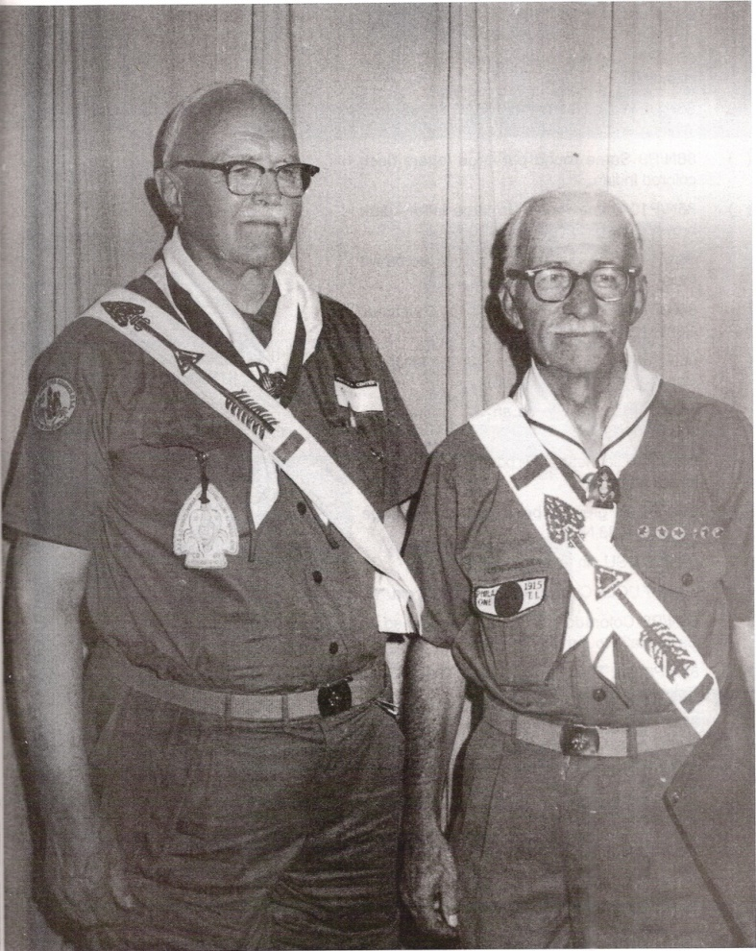
1921
The Grand Lodge is formed and the first Grand Lodge Meeting is held.
8 of 11 known lodges
were represented.
Elected Goodman
as Grand Chieftain

Slide 15
ROAD HAZARD AHEAD

Slide 16
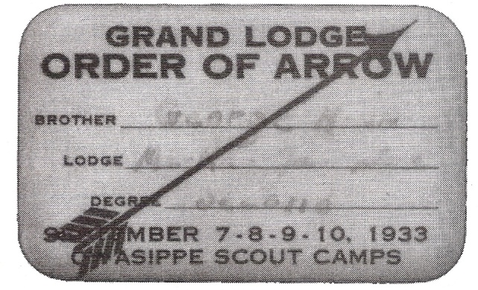
1922
Camp Societies come under scrutiny. The OA is in serious danger of ending before it is even barely started.

Slide 17
Mile Marker #6
What are some other early camp societies – some of which would later become part of the OA?
Ku-Ni-Eh
Gimogash
Firecrafters

Slide 18
1924
The Wimachtendienk W.W. becomes officially known as the “Order of the Arrow”

Slide 19
1926
The first Order of the Arrow patches are officially approved.

Slide 20
1928
The first Region Meetings were held. These were the predecessors to today’s Section Conclaves.

Slide 21
1931
Goodman appointed to the national office staff as Director of Program.

Slide 22
1932
The OA becomes an “Official Experiment”.
Rapid expansion with many other camp societies being absorbed.

Slide 23
1933
On August 23, 1933, President Franklin Roosevelt became the first and only President of the United States to be inducted into the Order of the Arrow.

Slide 24
Mile Marker #7
Who was the only President to be an Eagle Scout?
Gerald Ford

Slide 25
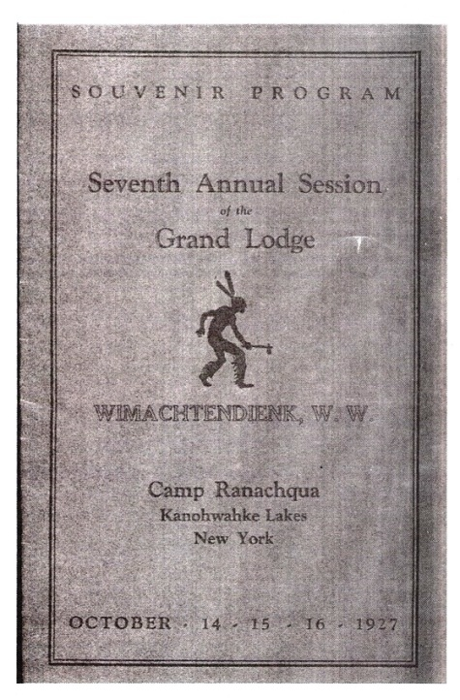
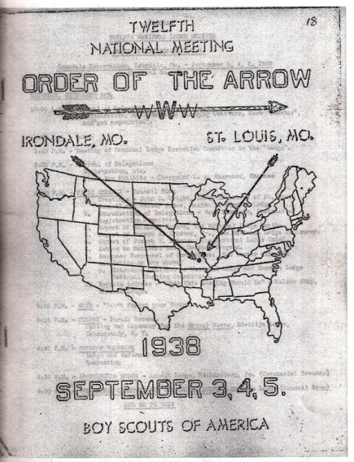
1934
Masonic terminology is phased out in our rituals and documentation.

Slide 26
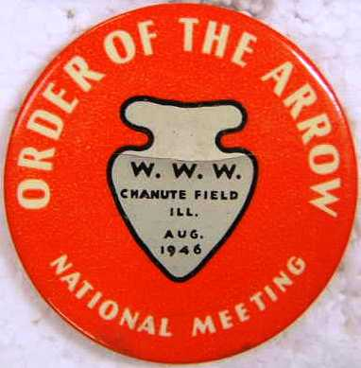
1940
The OA celebrated its 25th Anniversary
The DSA is established

Slide 27
SETTING CRUISE CONTROL

Slide 28
1948
The Order of the Arrow officially became a part of and fully integrated into the Boy Scouts of America.
First OA handbook was published.
The 1948 annual National Meeting is now considered the first NOAC.

Slide 29

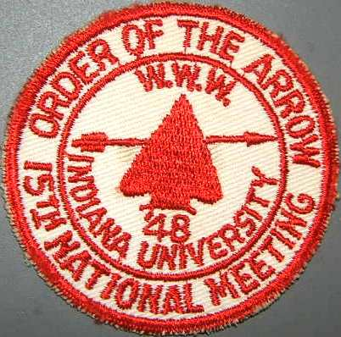

Slide 30
Mile Marker #8
What site has hosted the most NOAC’s?
Indiana University

Slide 31
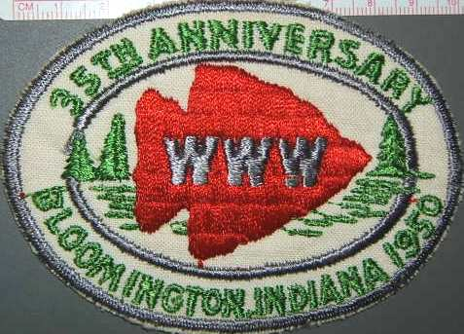
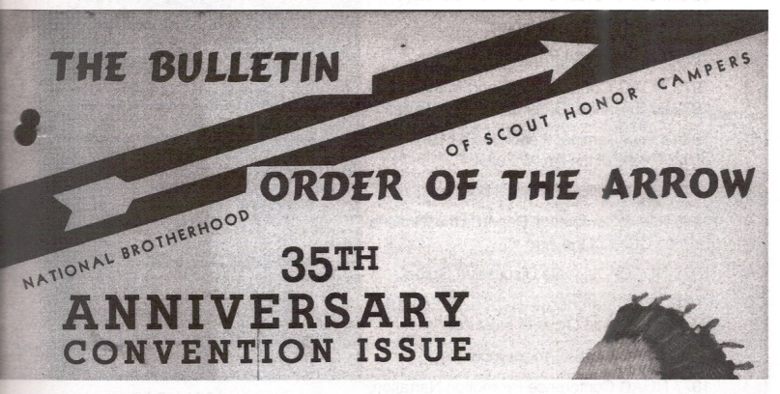
1950
35th Anniversary
First Youth planned and run NOAC
First OA Service Corps at National Jamboree

Slide 32
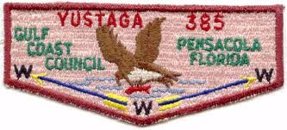
1954
Flap shaped patches were officially approved by the National OA Committee 35th Anniversary

Slide 33
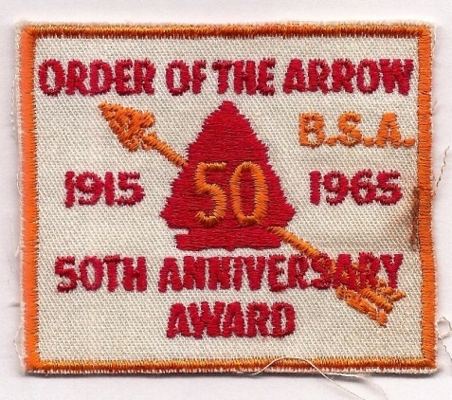
1965
The Order of the Arrow observed its 50th anniversary during 1965. A special 50th Anniversary award was created that could be earned by youth members of the Order.

Slide 34
Mile Marker #9
Besides the 50th Anniversary Award, what are the only other two patches that may be worn on the sash?
60th and 100th Anniversary Awards

Slide 35
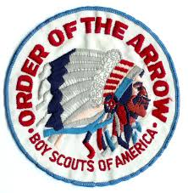
1967
First OA Jacket patch and Official Logo

Slide 36
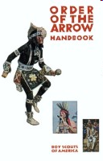
1969
First Elangomat

Slide 37
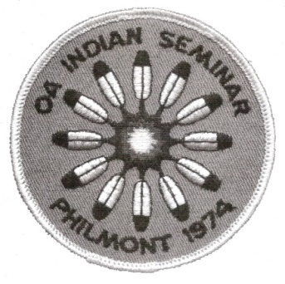
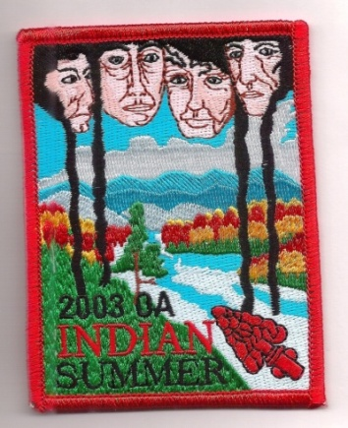
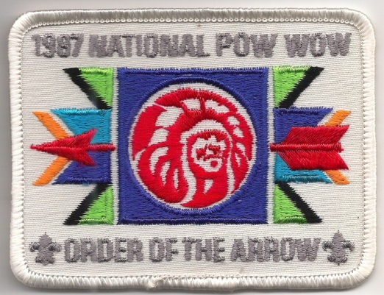
1974
The first National Indian Seminar was held. The semi-regular event would later go through program evolutions into the National Pow Wow and later into Indian Summer

Slide 38
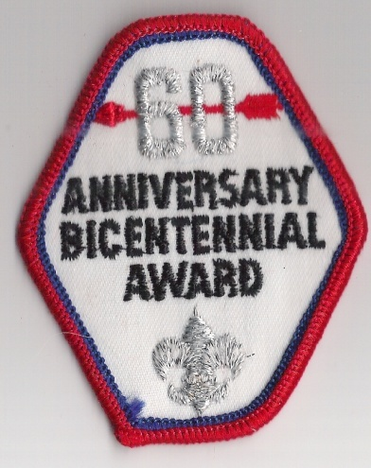
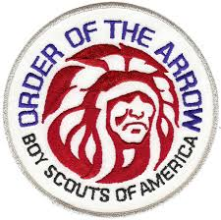
1975
OA celebrated its 60th Anniversary in 1975 and America was about to celebrate its Bicentennial. OA established the Order of the Arrow 60th Anniversary Bicentennial Award.
New Logo and Jacket Patch introduced.

Slide 39
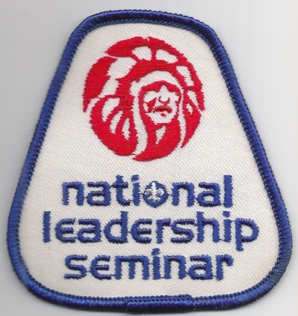
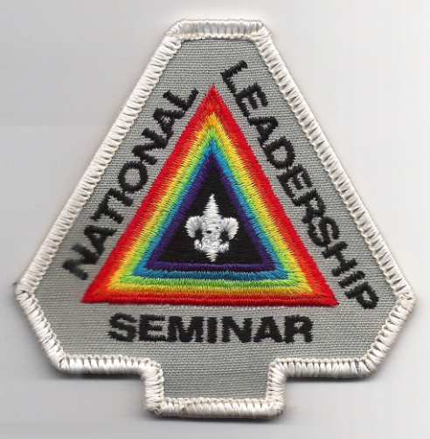
1978
The first National Leadership Seminars are conducted.

Slide 40
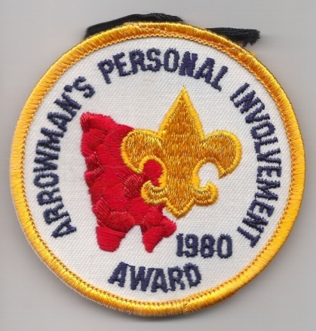
1980
Arrowman’s Personal Involvement Award was created.
On March 13, 1980 the Order of the Arrow’s Founder passed away at the age of 89.

Slide 41
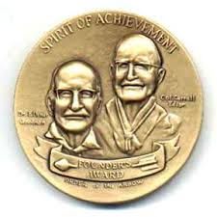
1981
The Founder’s Award is created.
The Elangomat Program is officially adopted as part of the Ordeal.

Slide 42
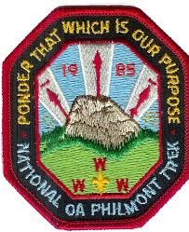
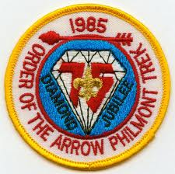
1985
First National Philmont Trek

Slide 43
1986
On October 26, 1986 the Order lost its Co-Founder Carroll A. Edson at the age of 94.

Slide 44
OUR TRIP GOES DOWN SOME NEW ROADS

Slide 45
1988
Women leaders were officially allowed in the OA in 1988. In late 1991 and early 1992 the first women Vigil honor members are indicted.

Slide 46
Mile Marker #10
Who is the first female National OA Committee Member and DSA Recipient?
Kay Trick

Slide 47
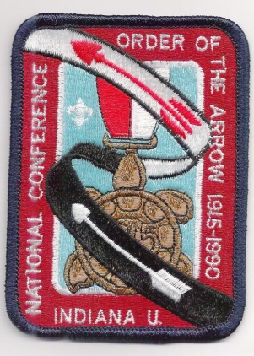
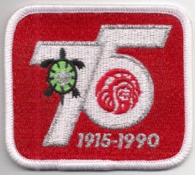
1990
The Order of the Arrow observed its 75th Anniversary in 1990. A special anniversary award was created that for the first time both youth and adults could earn.

Slide 48
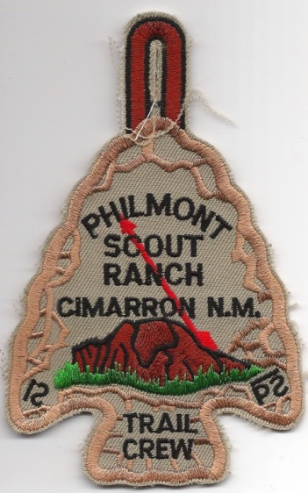
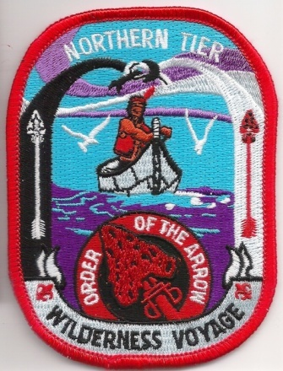
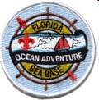
1995
The popular OA Trail Crew began its operations at Philmont. Similar service programs would later be added at Northern Tier, Seabase, and Bechtel Scout Reserve.

Slide 49
1998
50th anniversary of the Order of the Arrow having been formally and officially adopted by the BSA.
A new logo – our current one – introduced.
OA national website launched.
The OA changed its description from “Society of Honor Campers” to “Scouting’s National Honor Society”.

Slide 50
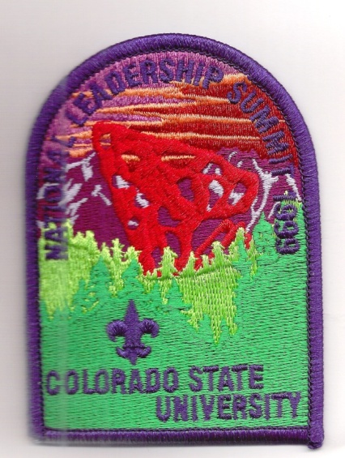
1999
The OA held first Key-3 National Leadership Summit at Colorado State University, from July 31st to August 3rd, 1999.

Slide 51
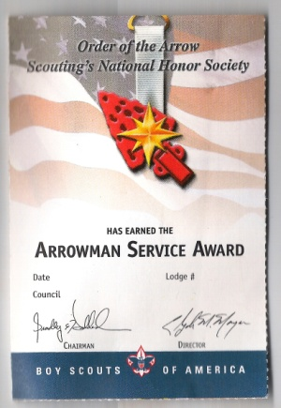
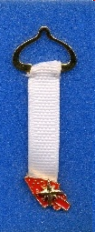
2001
The Arrowman Service Award was an Order of the Arrow award from 2001 through 2003.

Slide 52
2002
The Legacy of Servant Leadership Lifetime Achievement Award is created to recognize the Order's second and third generation "Founders"—Scouters who have built an enduring legacy to Scouting and the Order of the Arrow (OA) through a lifetime of cheerful service to others.

Slide 53
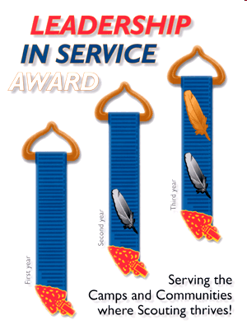
2004
The decision was made to no longer issue lodge numbers
At the NOAC the Leadership in
Service Award was announced. The
The award could be earned
three times beginning in 2005.

Slide 54

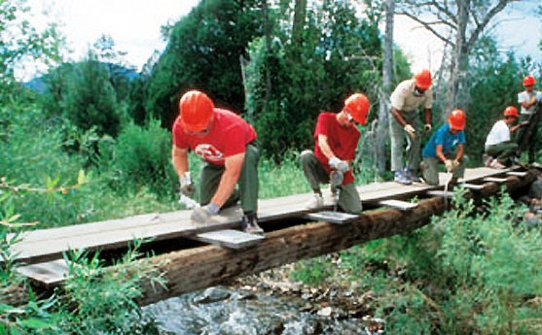
2008
5 National Forests across the country
5,000 Arrowmen

Slide 55
2011
SummitCorps “The New River Experience” was an OA service adventure in partnership with the U.S. National Park Service. Modeled after ArrowCorps⁵, 1,404 Arrowmen served during four one-week sessions throughout July 2011.

Slide 56
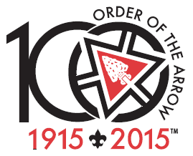
2015
New Brotherhood ceremony becomes official.
The largest NOAC in our history!
What’s next on our journey?

Slide 57
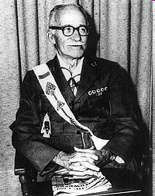
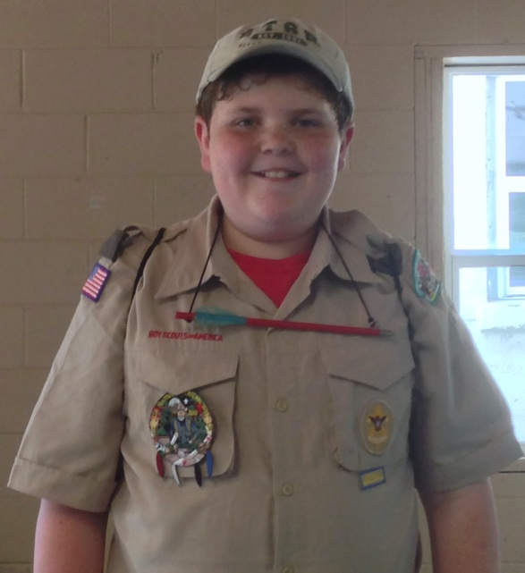
The Next 100 Years
………Well the Depends on you. It Starts With Us!

Slide 58
Mile Marker - Scoring
0 to 2 Glad you’re here!
3 to 5 Congratulations - you paid attention at your ordeal!
6 to 8 Excellent job - are you this good in school too?
9 to 10 Would you like to teach this class?

Slide 59
For Training Resources and More Information Visit:
http://training.oa-bsa.org/noac2015

