Slide 1

Panning for Gold, Discovering your Financial Resources
Part 3:“Successful and Sustainable Fundraising”

Slide 2
WHY FUNDRAISE?

Slide 3
RESOURCES
Purpose of “fundraising” to raise funds (money) for the Lodge, but is it just money?
Money is fungible – that which is received for one use can free funds for another use
Gifts in kind (Eagle project materials from Lowes/Home Depot)
Which stakeholder has which resource
Age, demographic, geography

Slide 4

“THE ASK”
Why do people give?

Slide 5

Wood Badge: “The Open Fist”

Slide 6
Details of The Ask
Who Asks?
How Much to Ask for?

Slide 7
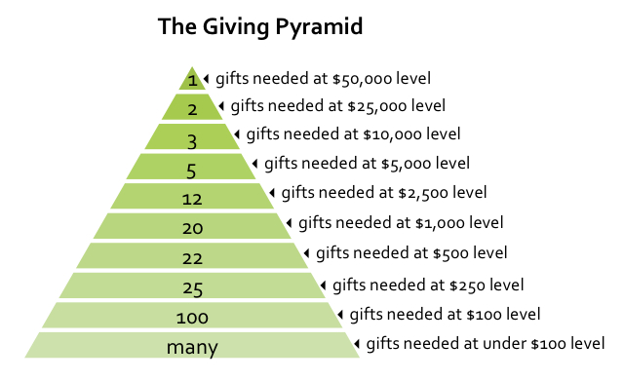
The Fundraising Pyramid

Slide 8
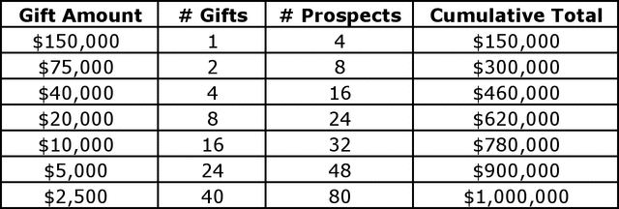
Gifts – Geometric and Logarithmic Progression

Slide 9
SELL STUFF- DO STUFF
(OTHER THAN PATCHES)
FUNDRAISING RULE # 1
    “Don’t spend more in COSTS than you RAISE”
  FUNDRAISING RULE # 2
    “Budget Twice, Cut Once”

Slide 10
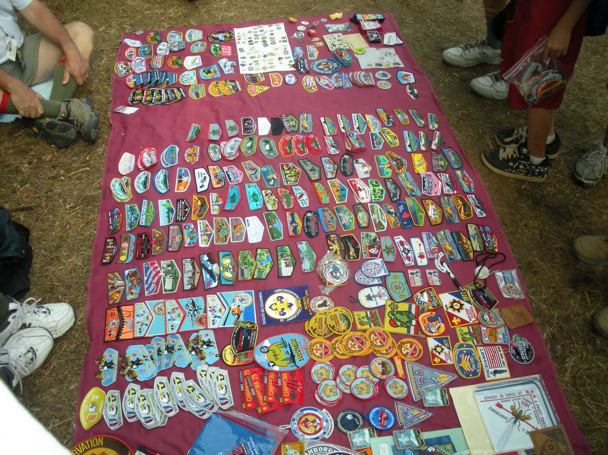
PATCHES!!

Slide 11
Conclusion
“It Starts With Us.”
Fundraising needs to be part of your annual Lodge plan and program. Don’t limit your fundraising just to patches or the one annual event you’ve done for decades.
Encourage youth and adult members alike to suggest alternate fundraising ideas and support further investigation and proposals.
Encourage collaboration and delegation to multiple members to work on a fundraising event or project to spread the work around, increase review of plans and costs and broaden exposure and participation from your Lodge, Council and Community.
And remember…*FUNDRAISING RULE # 3: “Keep the FUN in FUNDRAISING!”

Slide 12
For Training Resources and More Information Visit:
http://training.oa-bsa.org/noac2015

