Slide 1
Arrowman 101
Taking the Wheel

Slide 2
Objectives
Explain that each Arrowman charts his own path beyond Ordeal.
Demonstrate that the journeys individual Arrowmen take may have different routes, stops, and destinations but
they all involve a search for the arrow.
Guide Arrowmen in outlining and developing a journey of self discovery and search for the arrow.
Enable Arrowmen to begin their own journey, leaving a legacy along the way, helping to define the next 100
years of the Order of the Arrow.

Slide 3
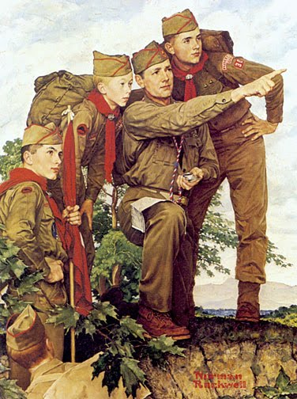
YOUR JOURNEY IS JUST BEGINNING

Slide 4
THE ORDER’S HISTORY IS MADE UP OF OUR INDIVIDUAL JOURNEYS

Slide 5
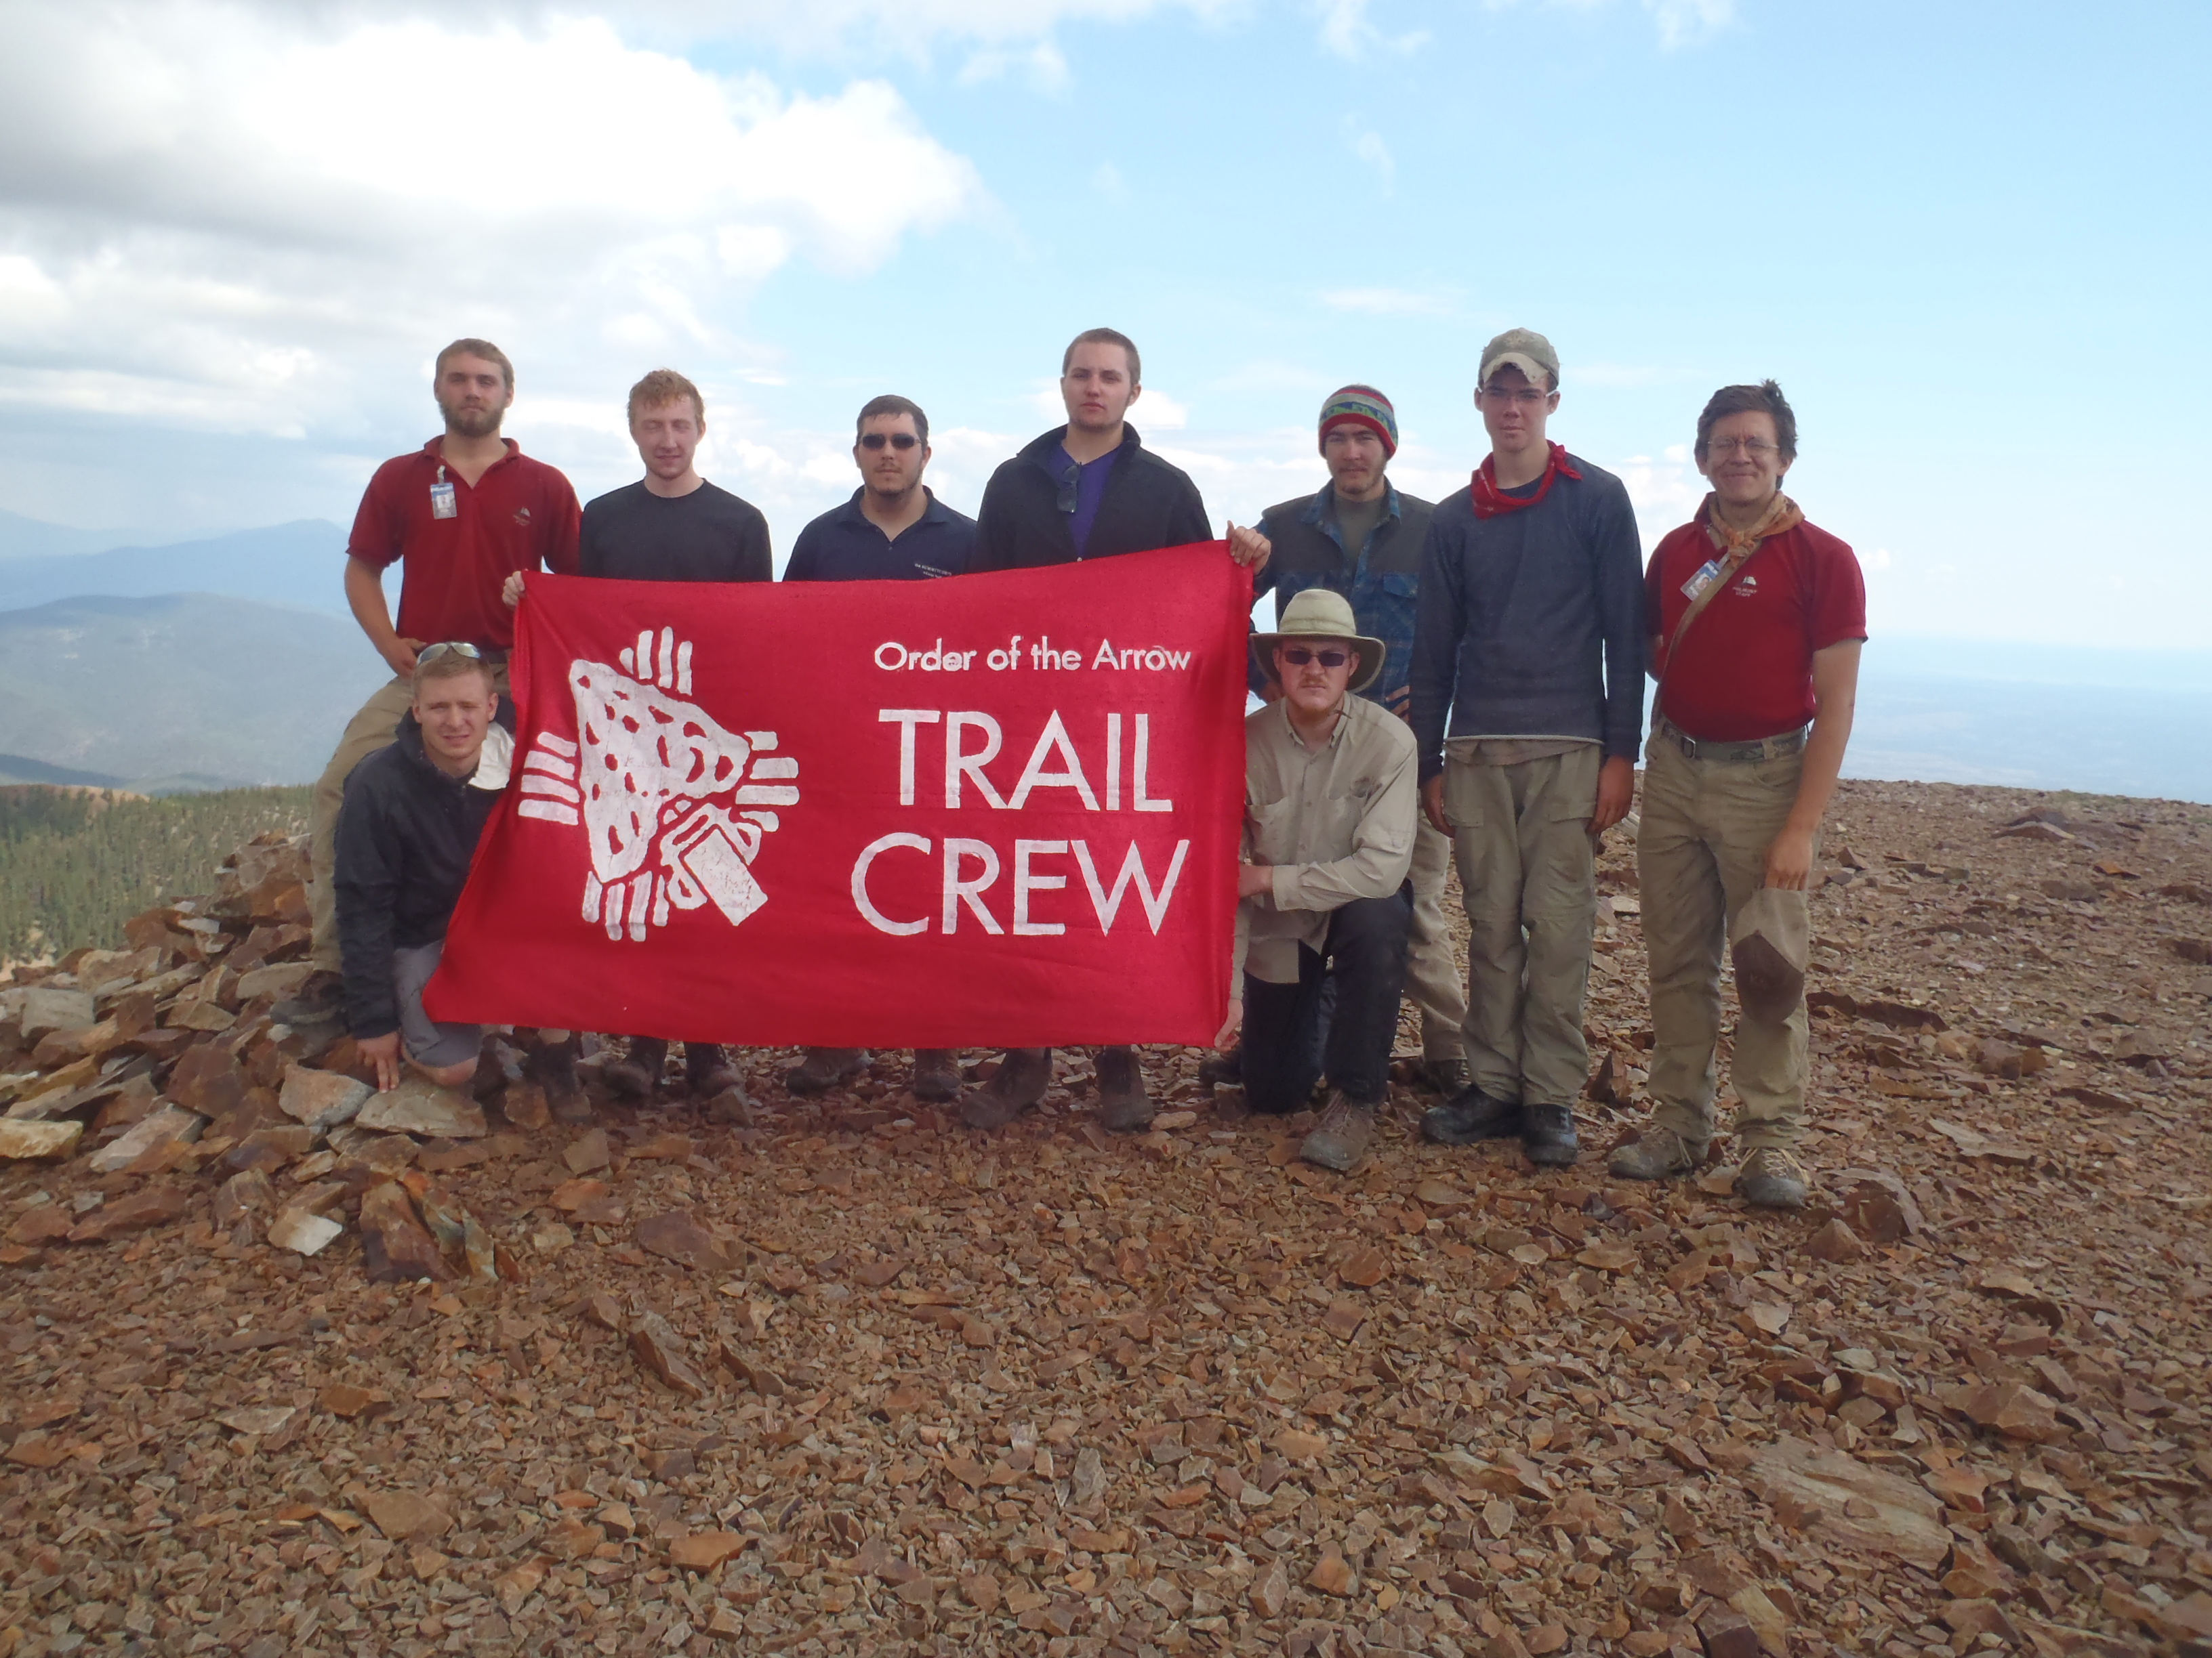
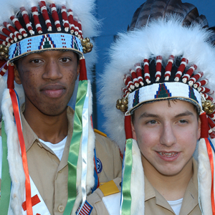
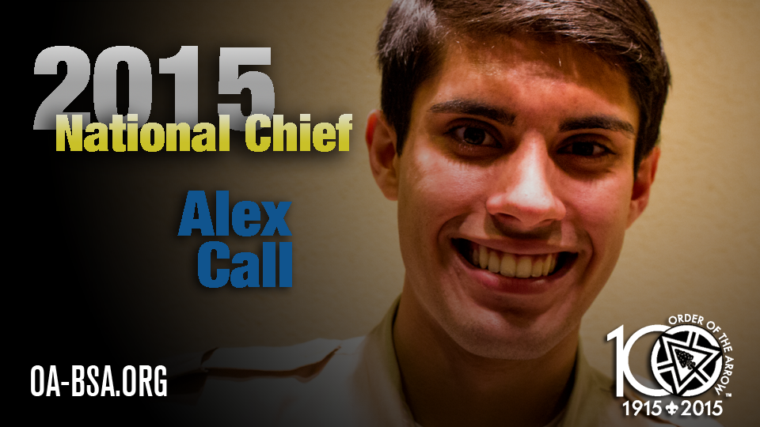
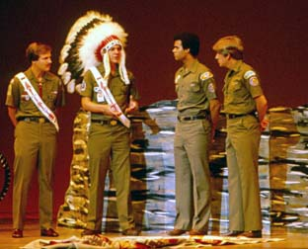
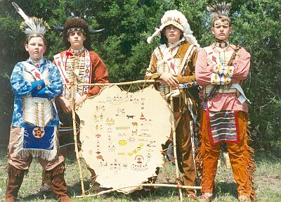
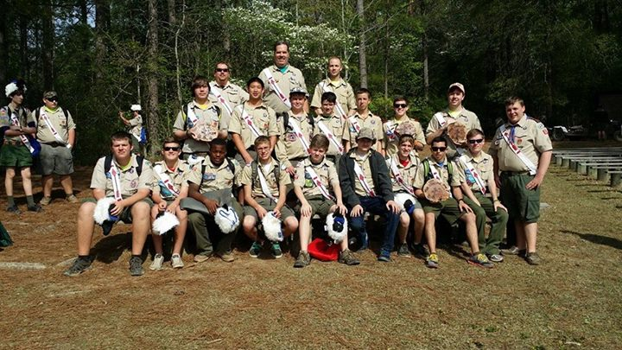
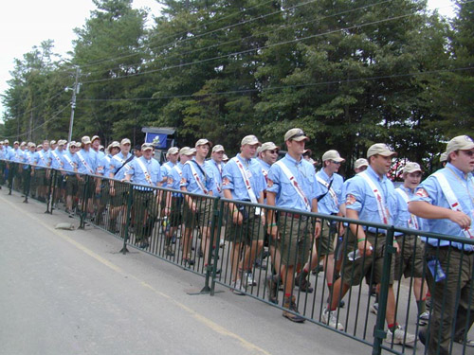
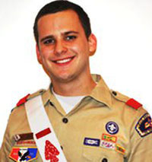
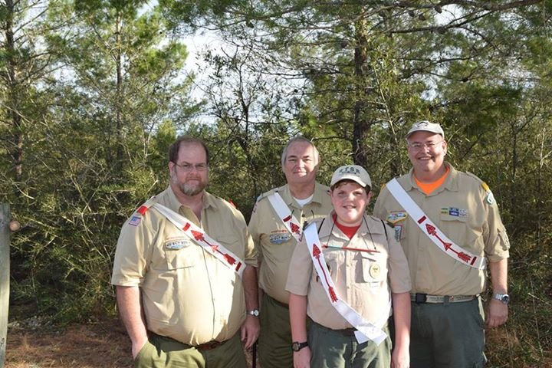
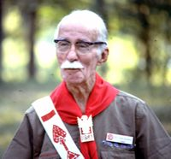
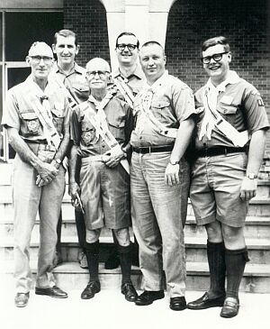
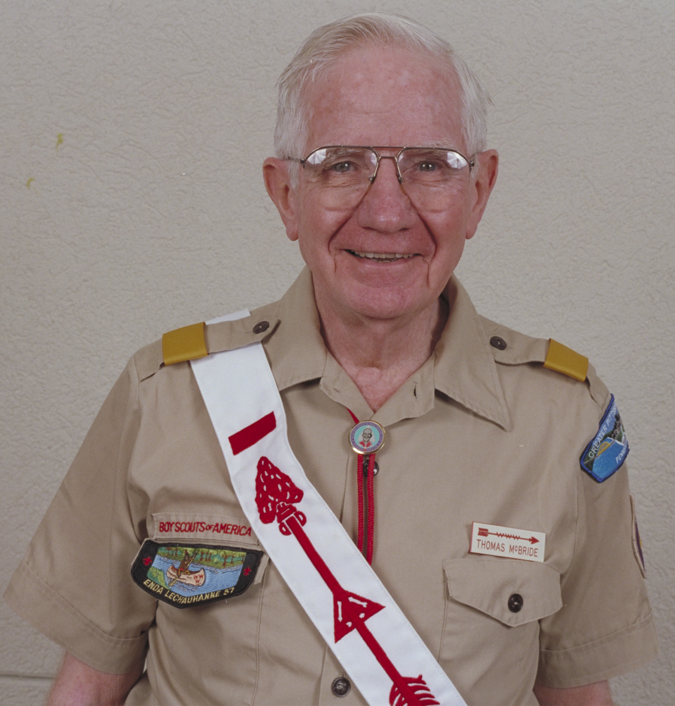

Slide 6
TAKING THE WHEEL

Slide 7
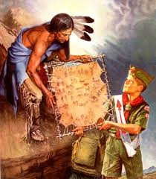

Slide 8
YOU DON’T NEED A DRIVER’S LICENSE TO TAKE THE WHEEL

Slide 9
STOPS, ROUTES, SIDE TRIPS,SWITCHBACKS, REST AREAS ALONG THE WAY

Slide 10
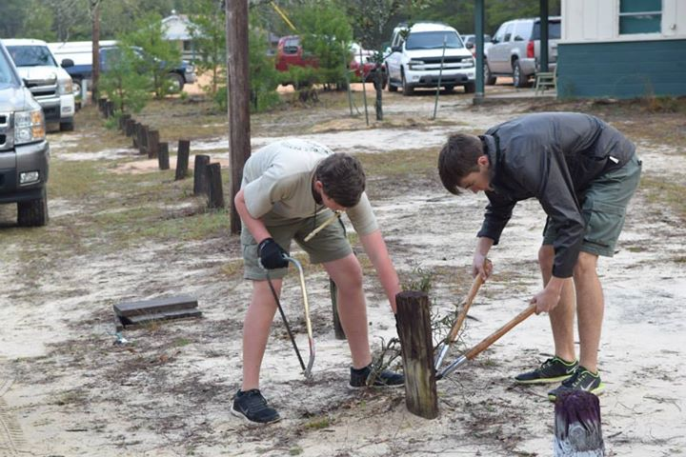
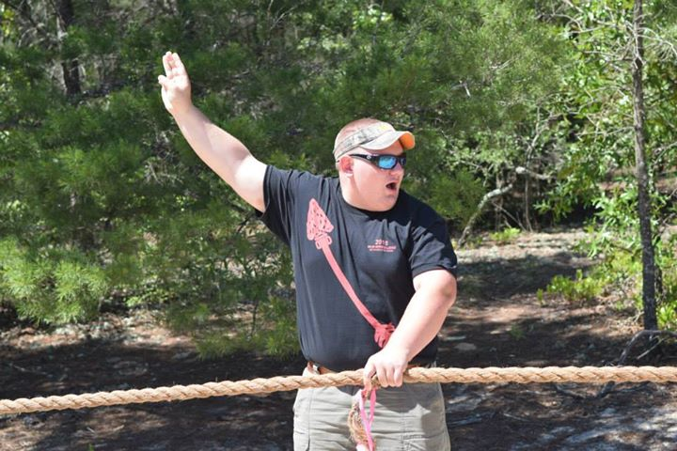

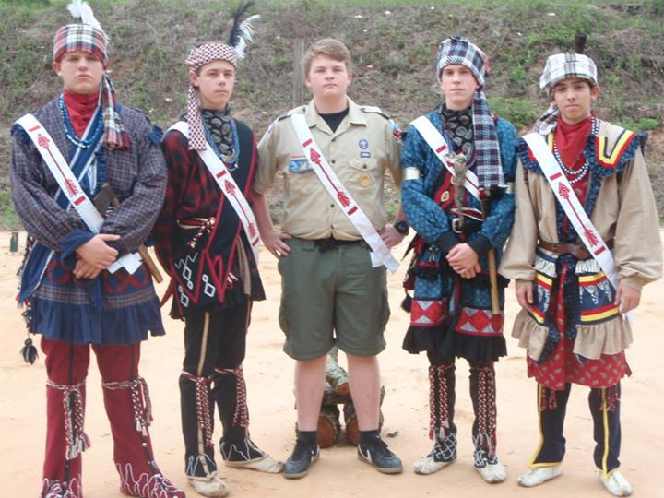

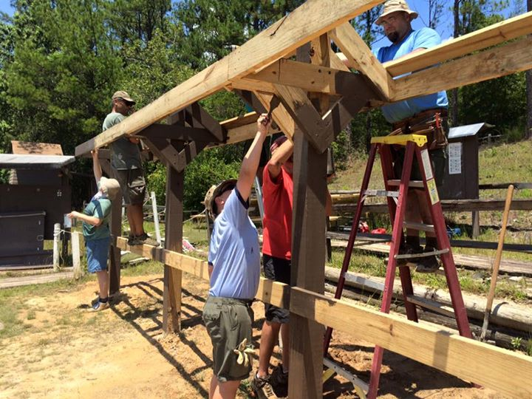
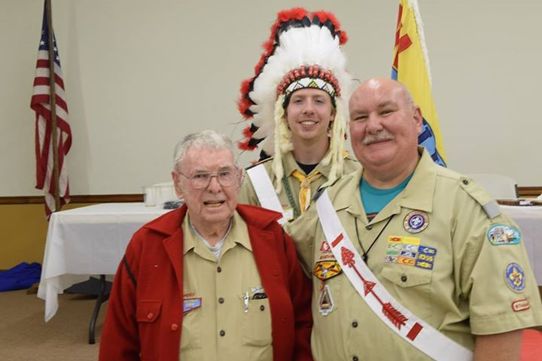
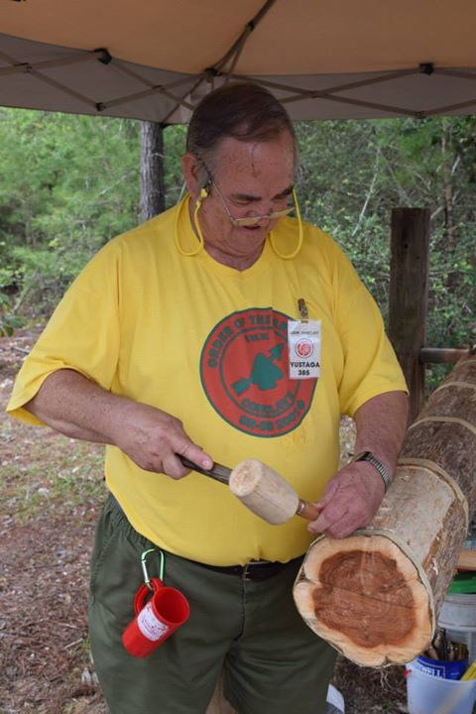
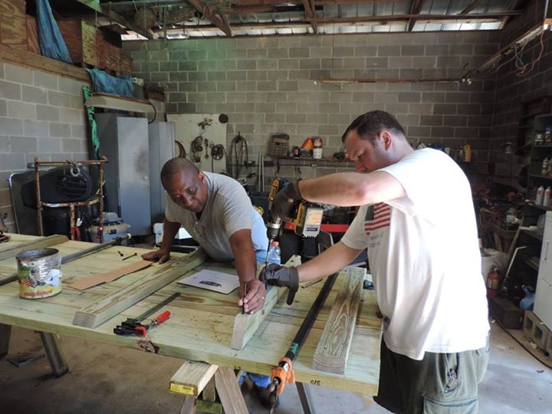

Slide 11
HAVE PASSION

Slide 12

Passion = Fuel
Thank the person who first inspired your passion.
Re-experience the Ordeal

Slide 13
HAVE A VISION
“The act or power of imagination” and as “a mode of seeing or conceiving”.

Slide 14


Slide 15
Your Vision
Now chart your course. Draw your map. Dictate your vision.
Make a list of 10 things that you want to do, see, or experience as a member of the OA.
This is your OA bucket list. This is your vision. This is your roadmap.

Slide 16

Membership in the Order of the Arrow is not based on what you have done, but what you are expected to do in the future.
The future begins right now – right here.
It Starts With Us!

Slide 17
For Training Resources and More Information Visit:
http://training.oa-bsa.org/noac2015

