Slide 1
eScouting
Using Your Site

Slide 2
Introduction
A website is a vital communication tool
What do you want a website to do for you?
What do you look for on a website?
How do you find web content?
Discuss what you look for in a website

Slide 3

What is a website for?
Contact information
Calendar of events
News
Promotion
Connect with national and section sites
Two way connection with social media

Slide 4
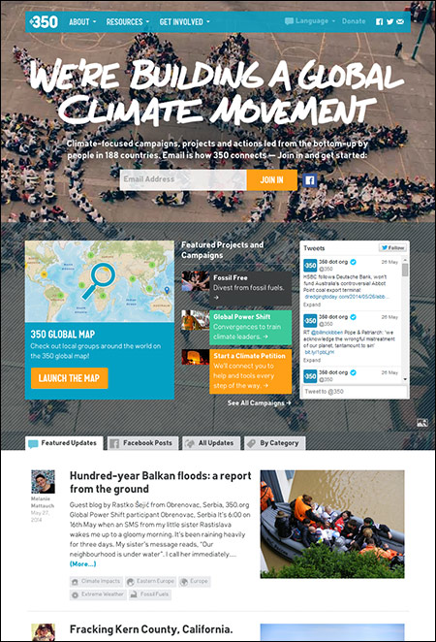
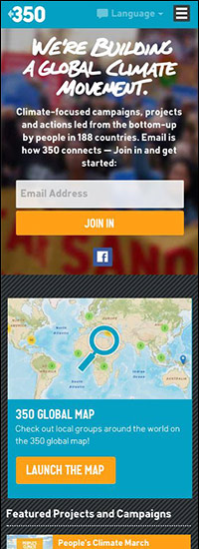
Example of a successful site

Slide 5
What does it take to get there?
Web hosting
Domain name registration
HTML / PHP / Perl / Python / JavaScript / CSS / RSS / APIs
Photographer
Videographer
Digital editing
Copy writer
Social media management
Large number of followers
Knowledge of scouting, the OA, and lodge history
Large collection of memorabilia
Attend every event
Attend every meeting

Slide 6
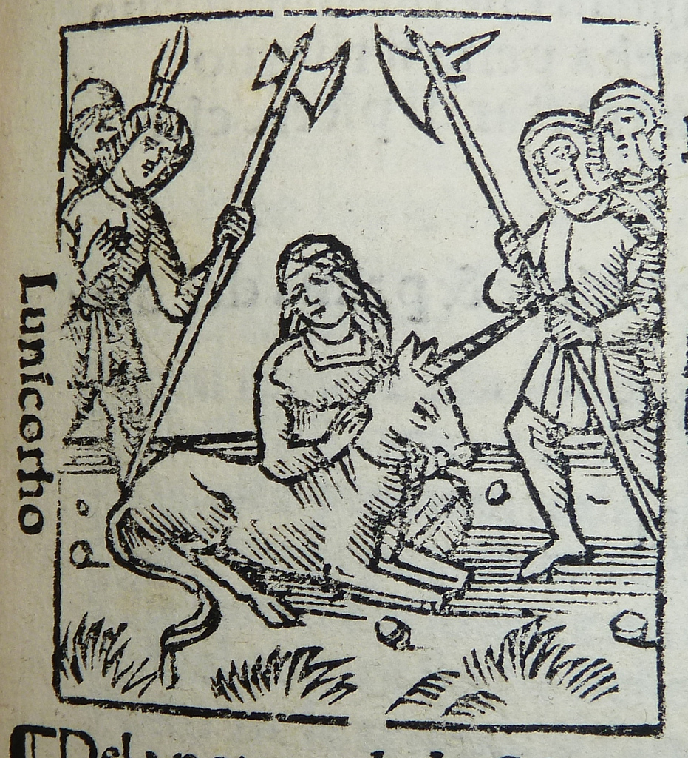
Unicorns
It will take a team effort
People who can do even a few different tasks will be uncommon
Someone who can do it all is as rare as a unicorn. Don’t waste your time chasing unicorns. Slice the job up into pieces volunteers will enjoy.

Slide 7
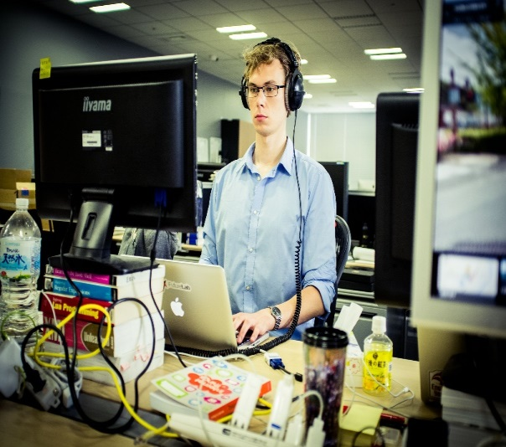
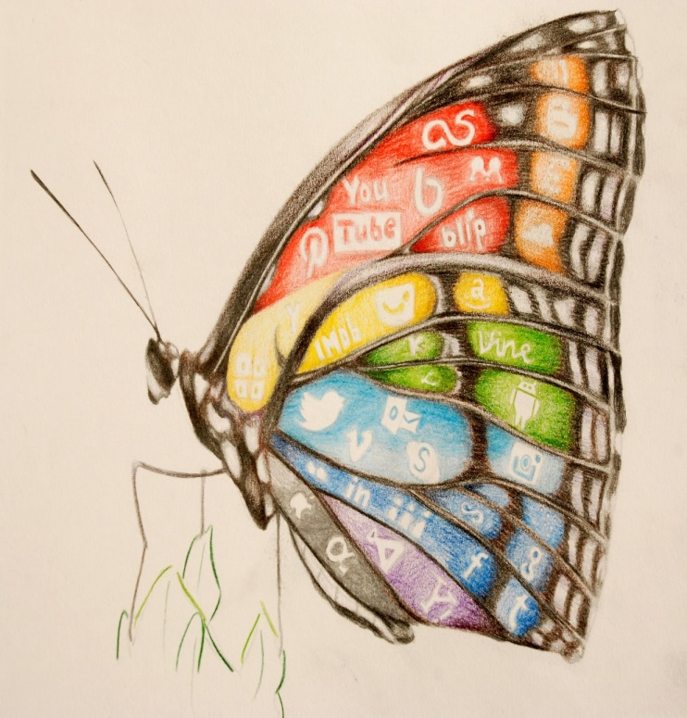

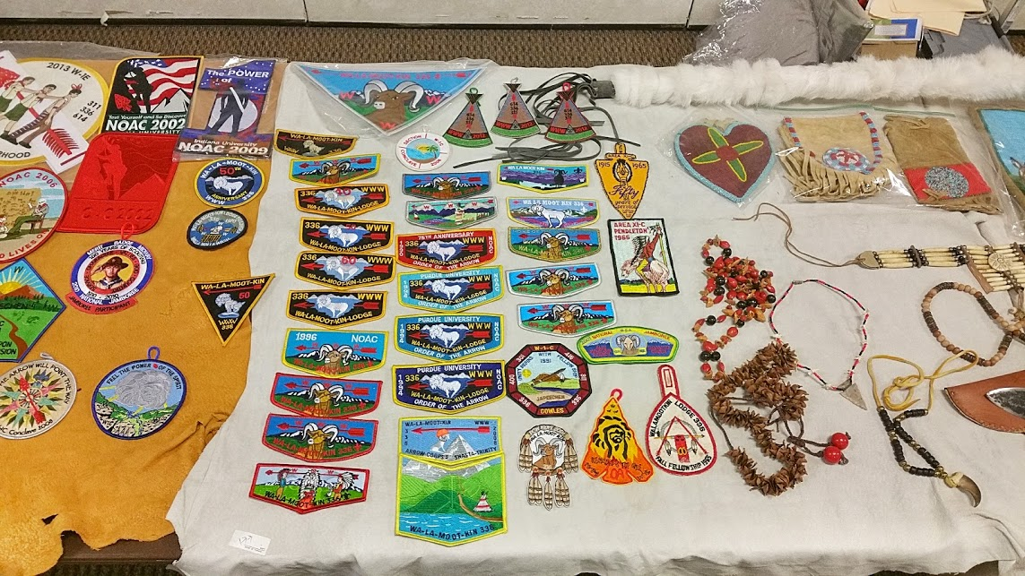
What roles should I look for?

Slide 8

Technical Leads
What they do:
  Run the nuts and bolts of the site
  Make sure it is updated, the right plug-ins or widgets are available and configured
  Make sure others get appropriate access to the site
  Help those unfamiliar make their first few posts and be available for tech support
How to ask:
  Ask for specific tasks
  Tech is specialized. If they say no, ask what they can help with.
  Focus on how much their skills and knowledge can enable others to contribute

Slide 9

Social Media Experts
What they do:
  Aggregate content from those not comfortable posting themselves
  Keep up to date on upcoming events
  Always have a positive attitude
  Post often
  Willing to talk to others at events
How to ask:
  Let them know how you admire how they connect with others
  Find what makes their posts special
    Good writing
    Great photos
    Humor

Slide 10

Content Generators
What they do:
  Take lots of photos and video
  Share their collections
  Plan events
  Lodge historians
  Take notes at meetings
How to ask:
  Admire the hard work they put into what they do
  Let them know you would like to help them share what they do with more people

Slide 11

Key Promoters
What they do:
  Extend the reach of posts
  Be enthusiastic
  Consistently re-post information
How to ask
  Let them know how well liked and respected they are
  Emphasize how important they are to getting the word out

Slide 12
Summary
How will you help your lodge website?
It takes a diverse set of skills and personalities to develop a successful web pressence
Ask someone in your lodge to help
Get them to ask someone they know to help
Share your ideas for improving your lodge website.

Slide 13
For Training Resources and More Information Visit:
http://training.oa-bsa.org/noac2015

